Slide 1
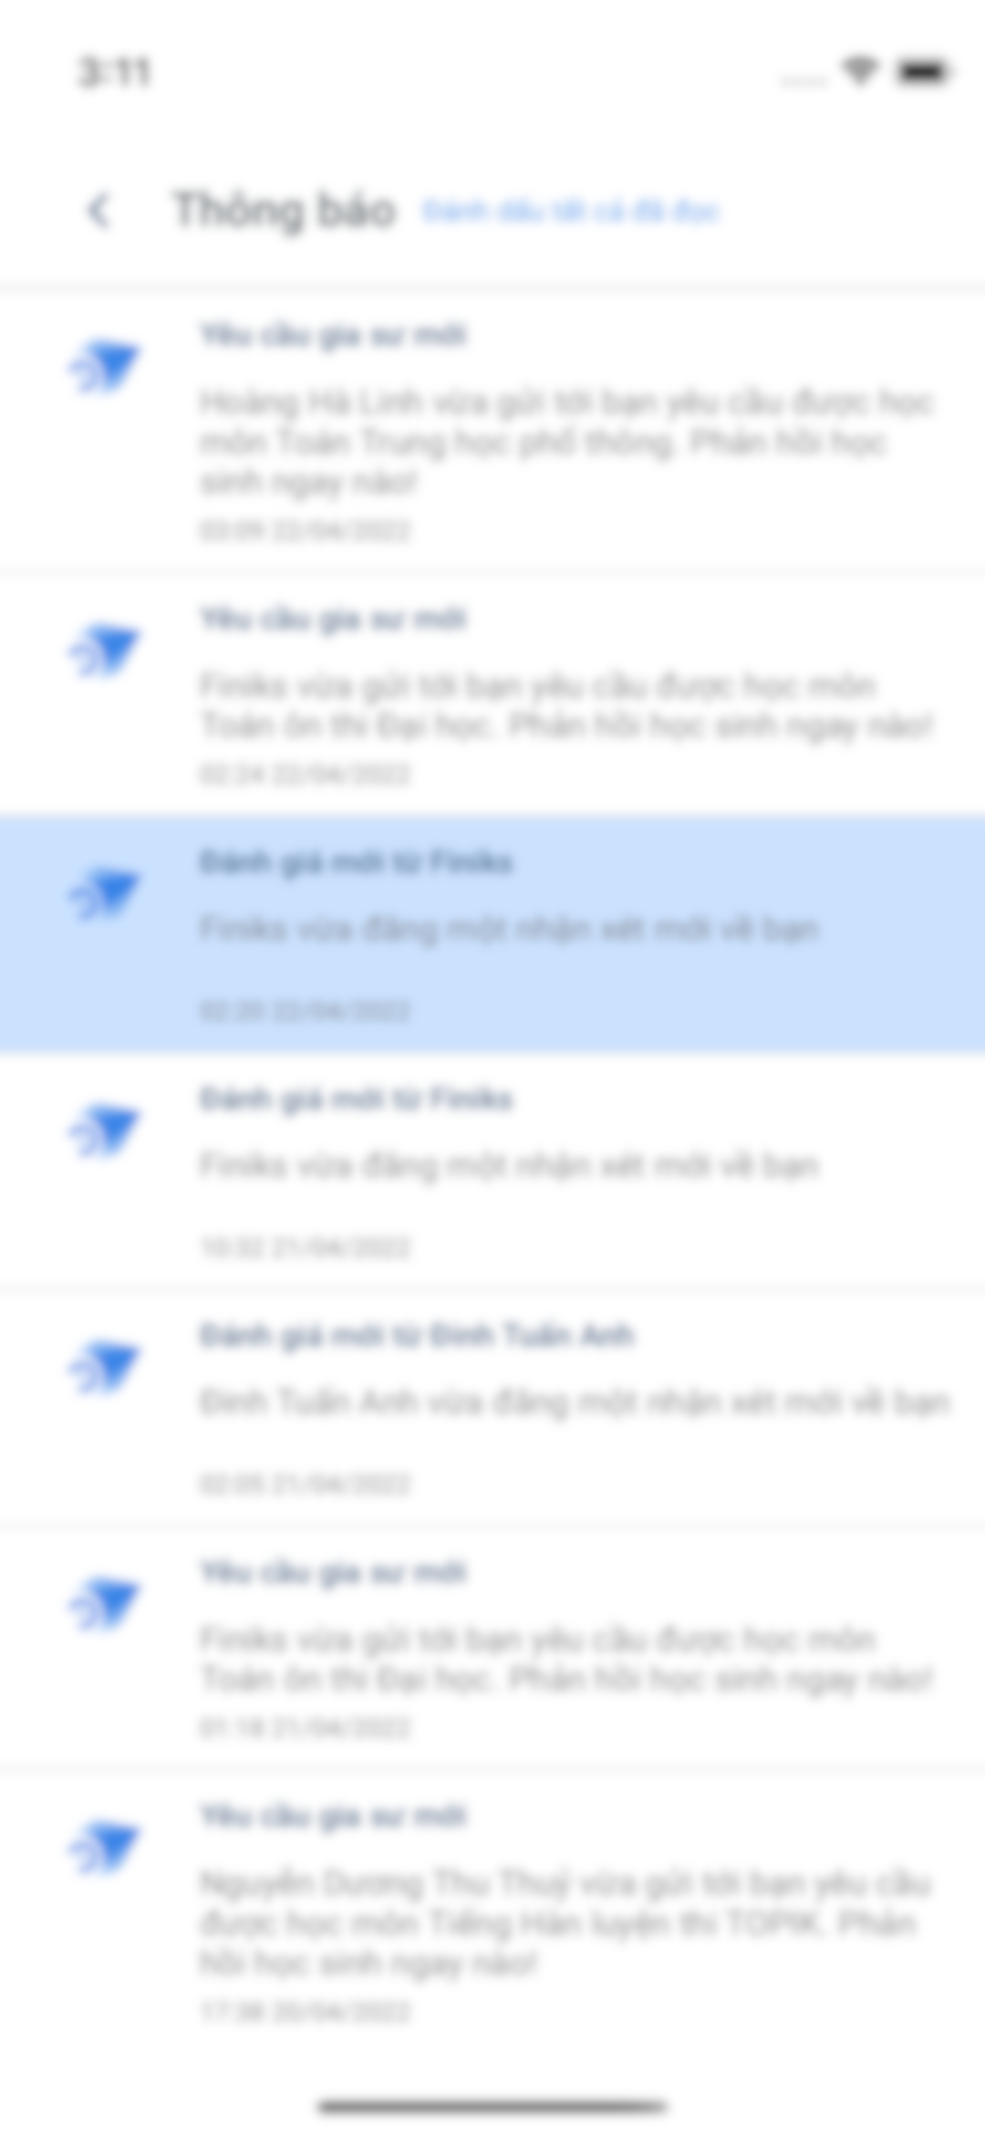
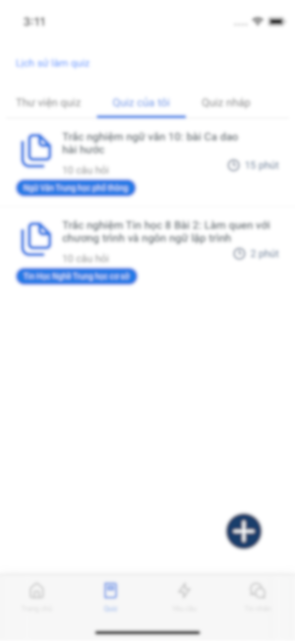
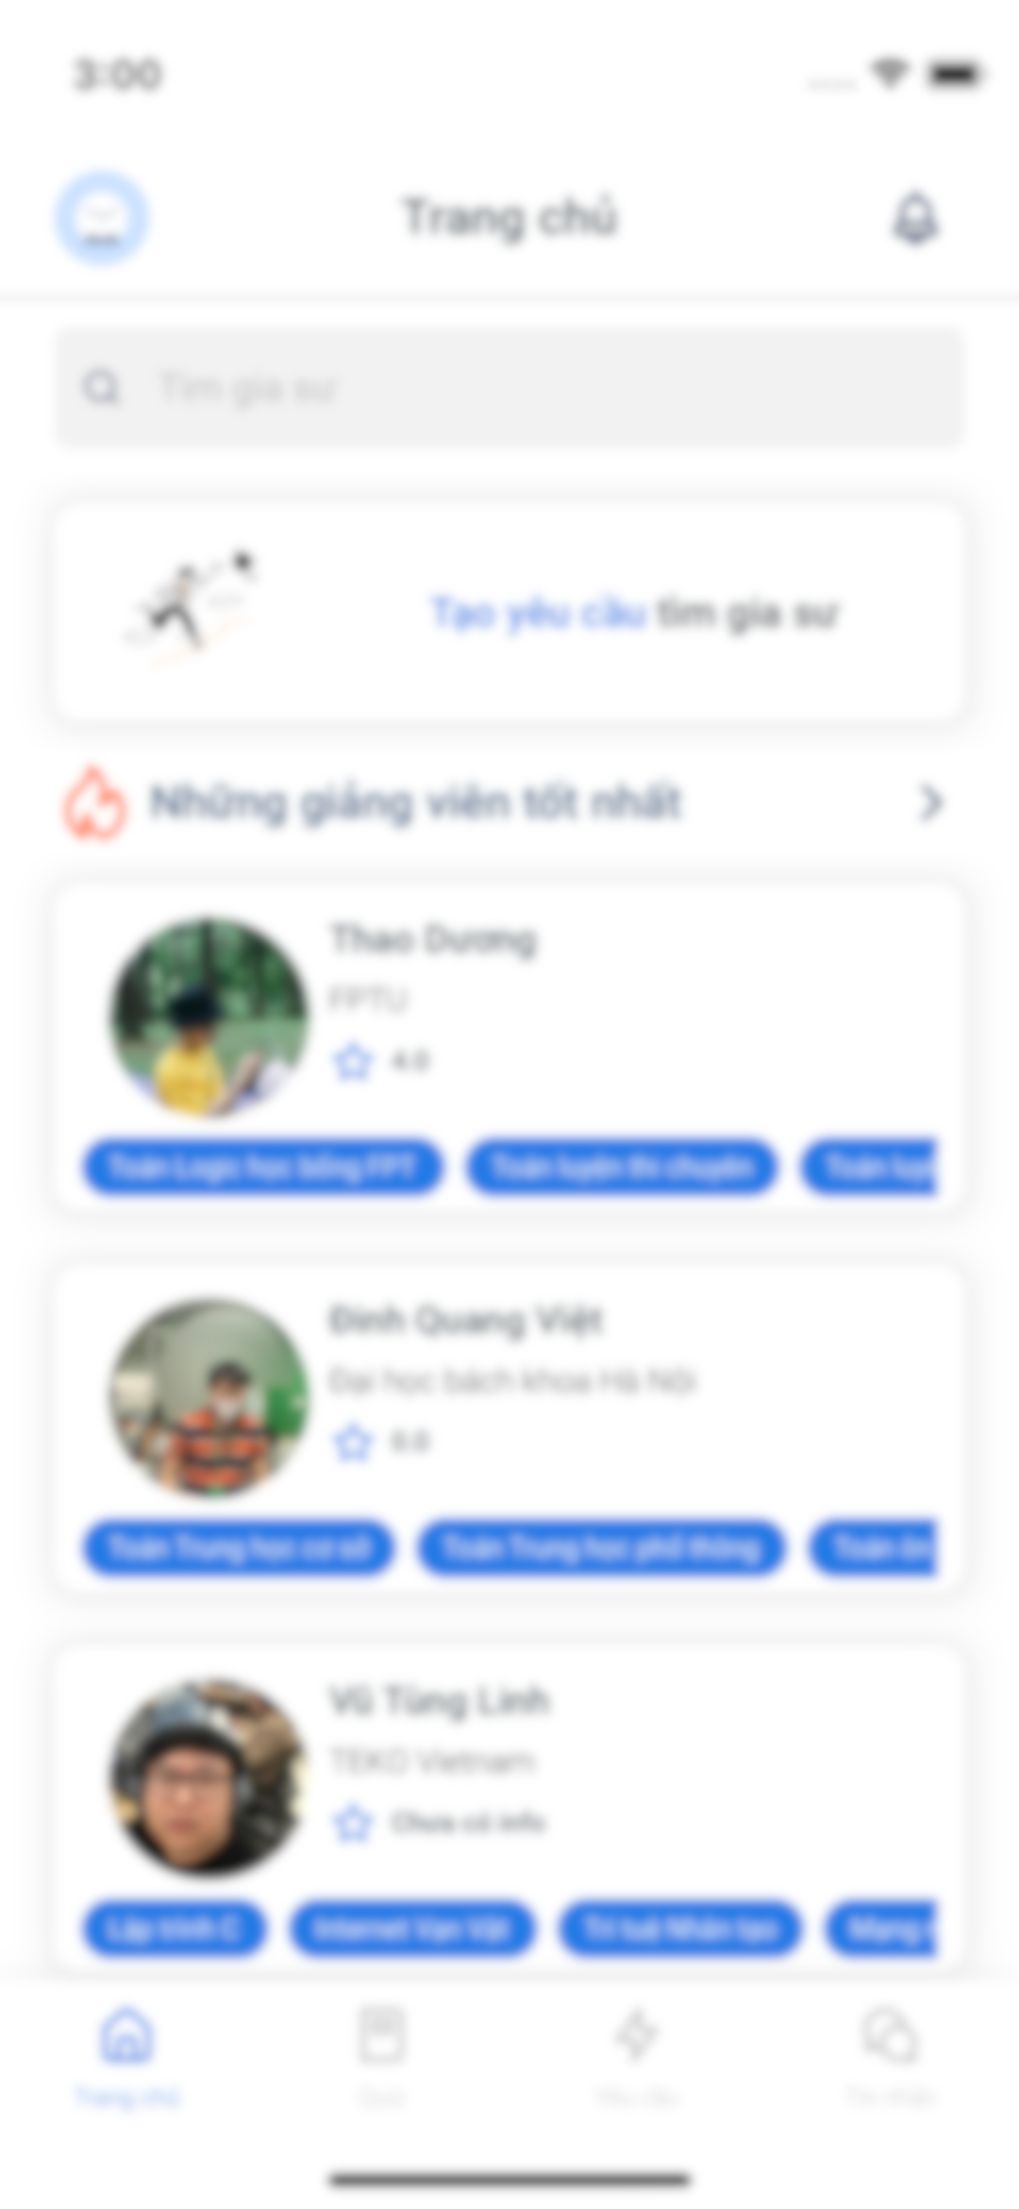
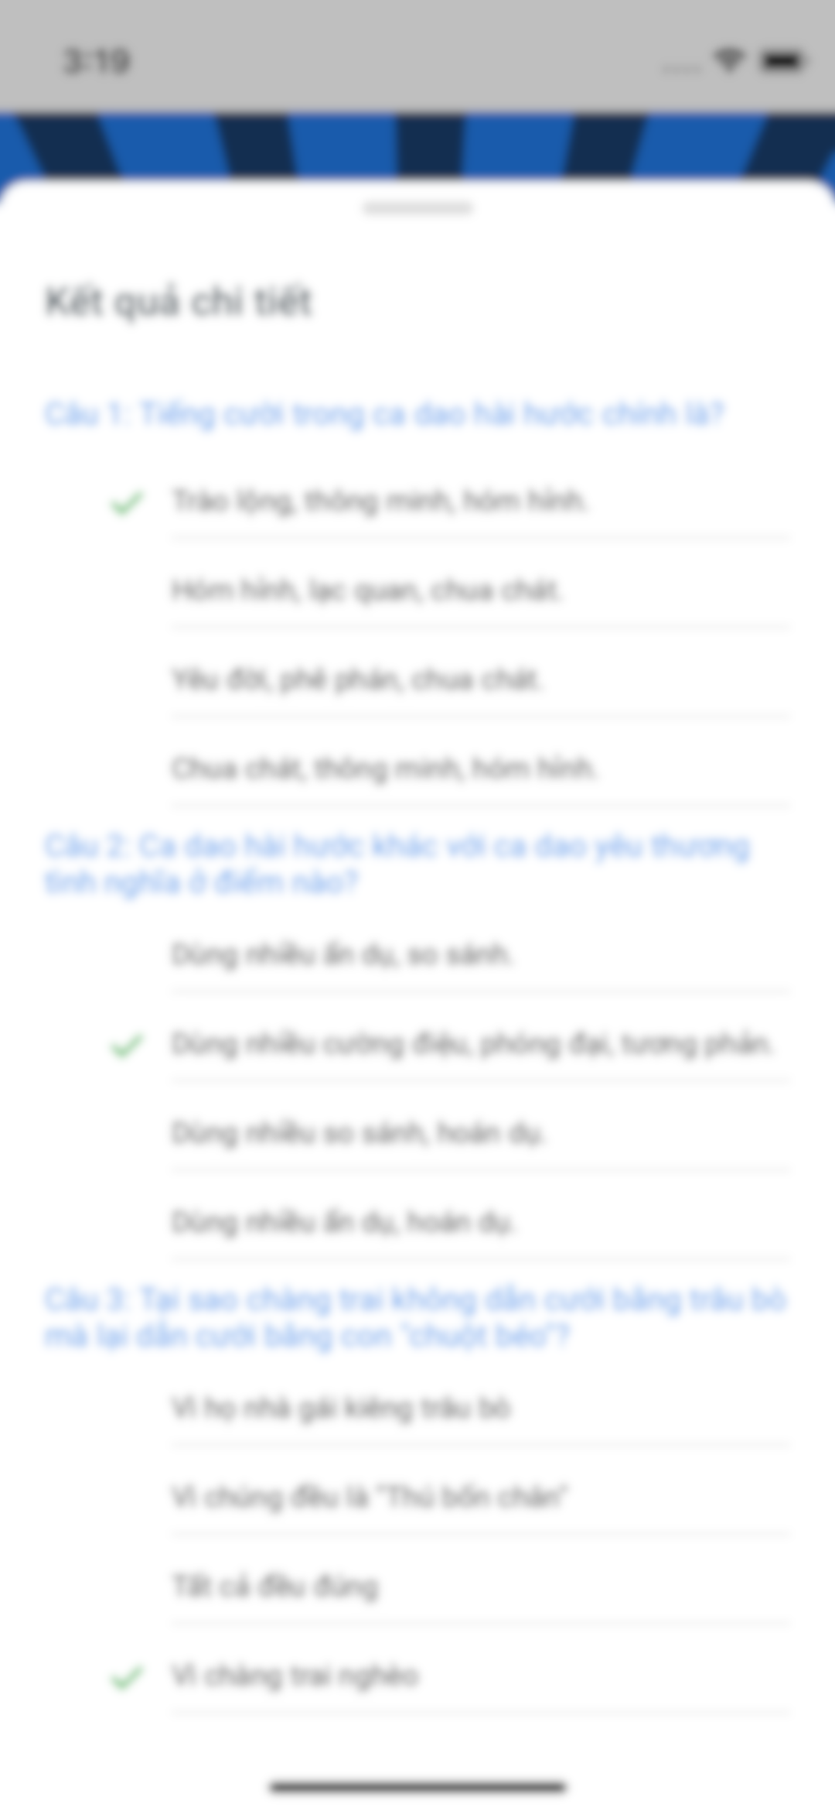
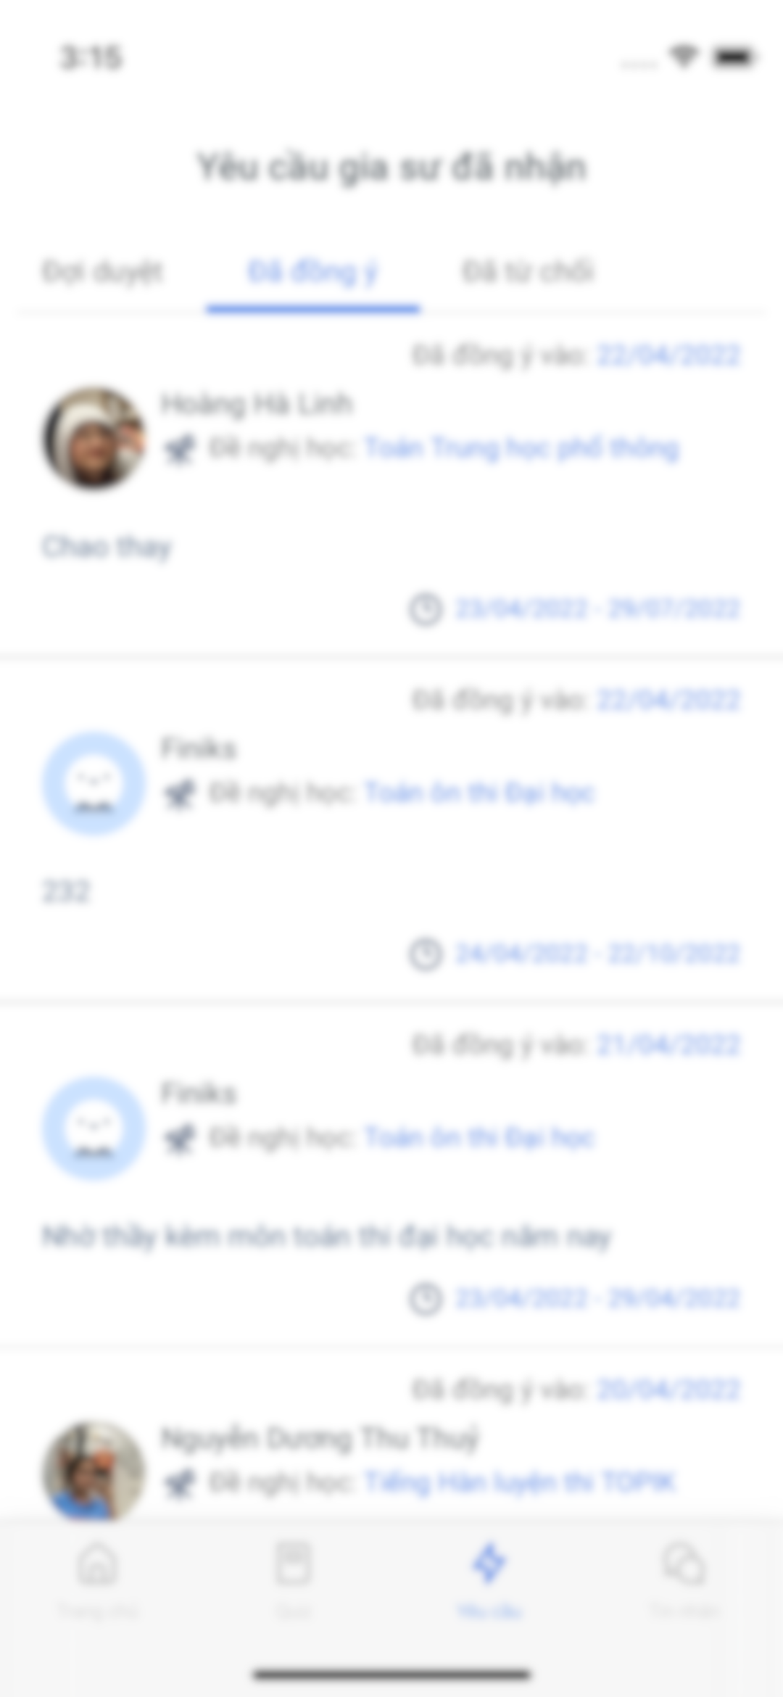
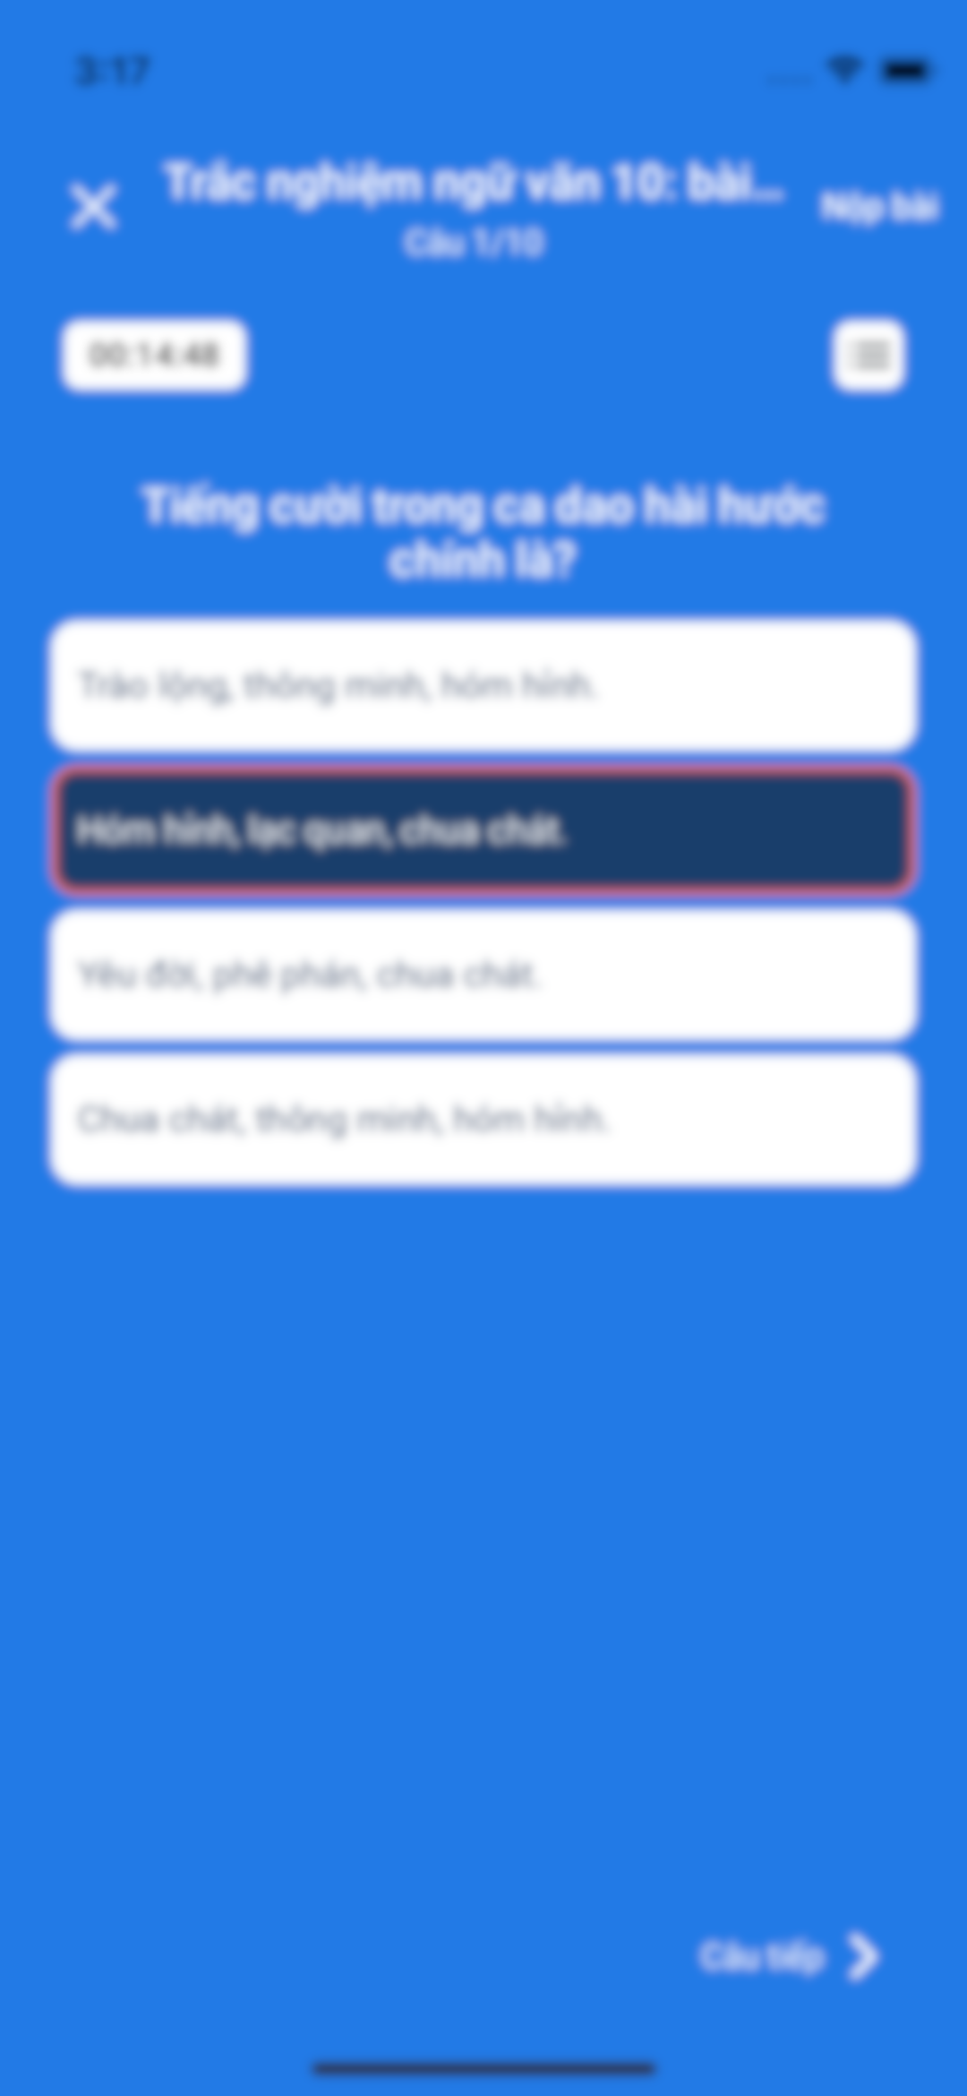

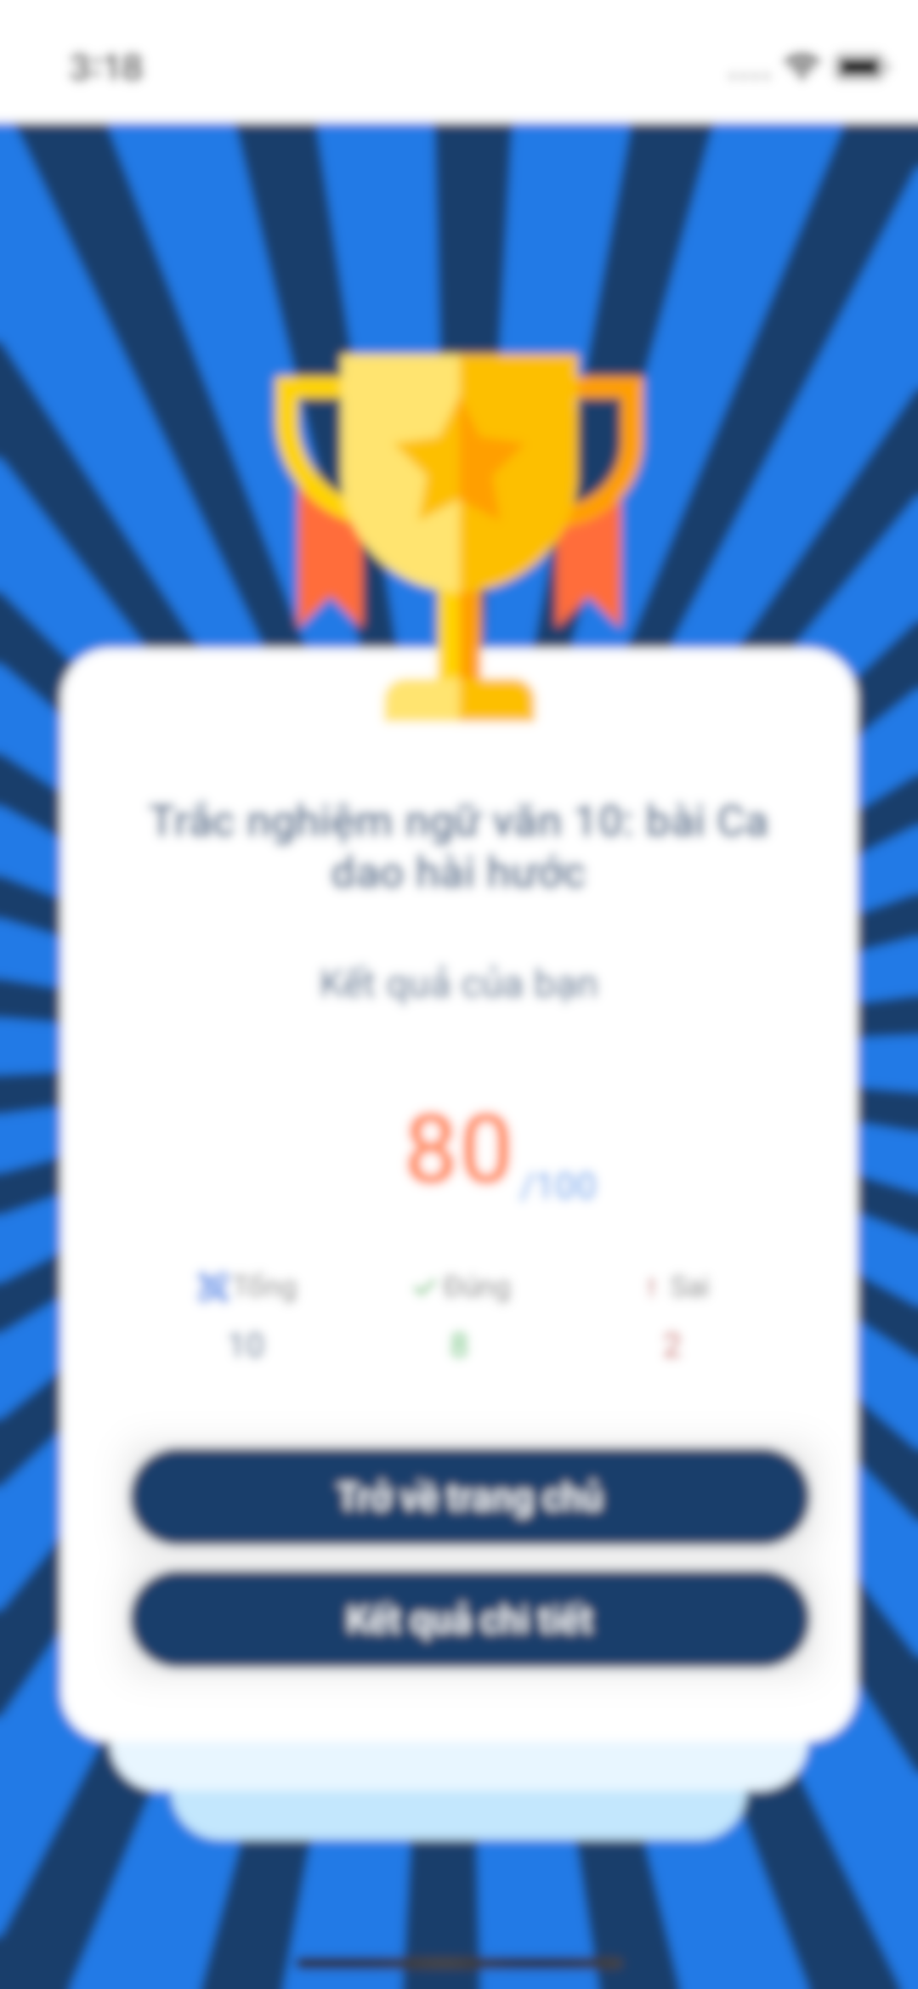
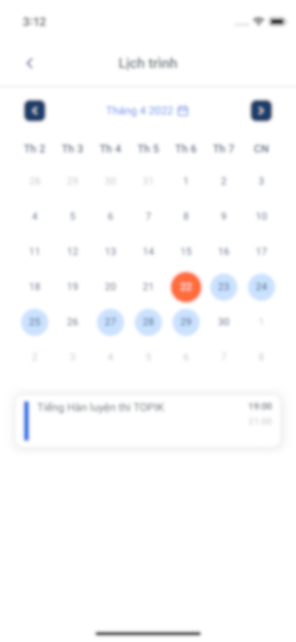

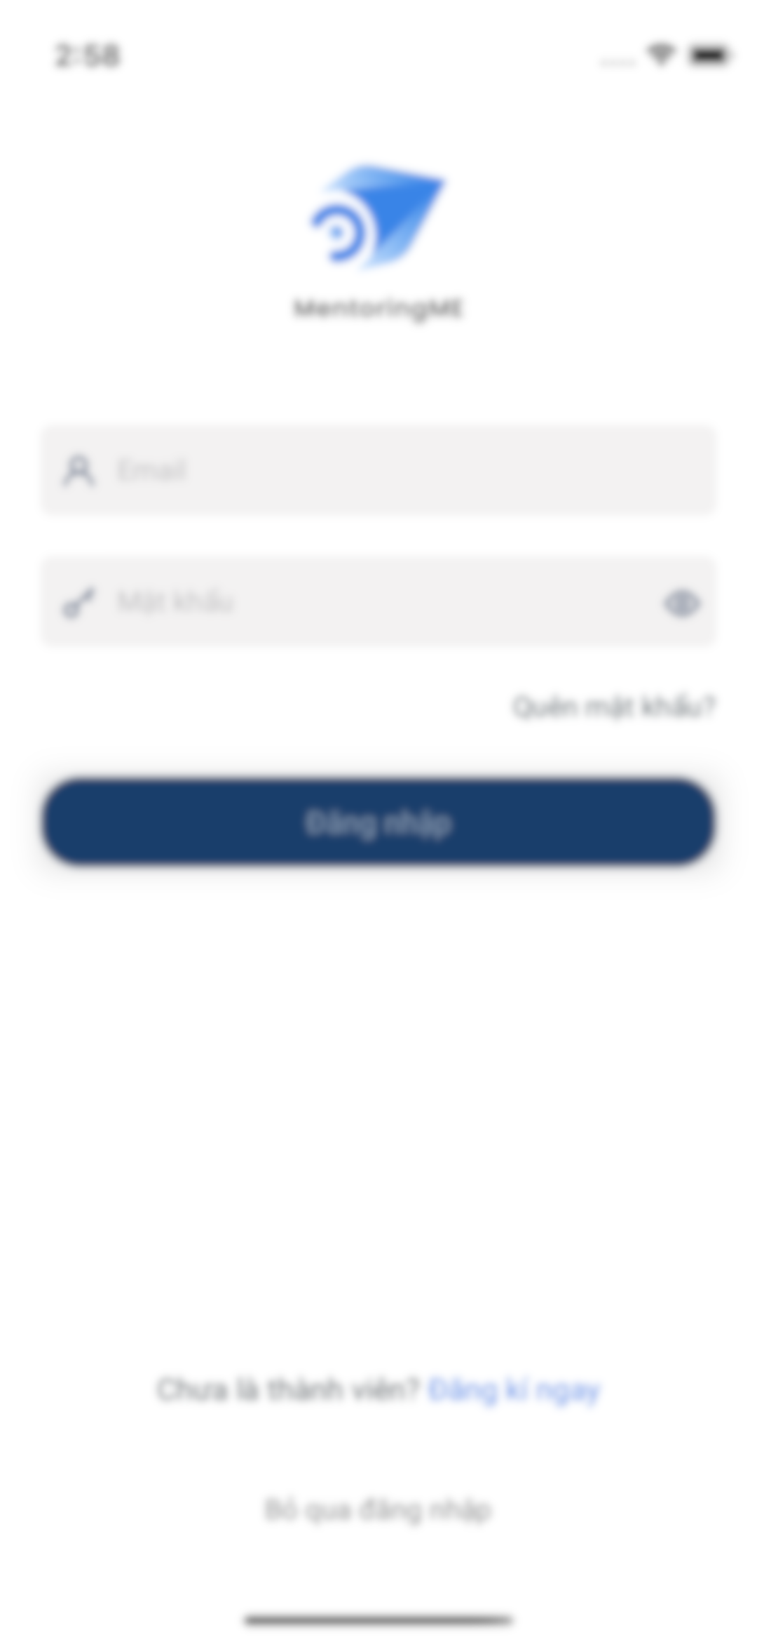
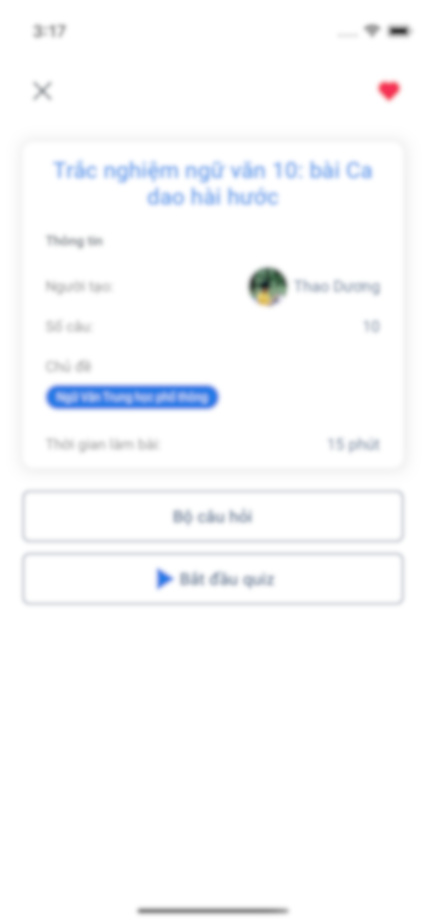
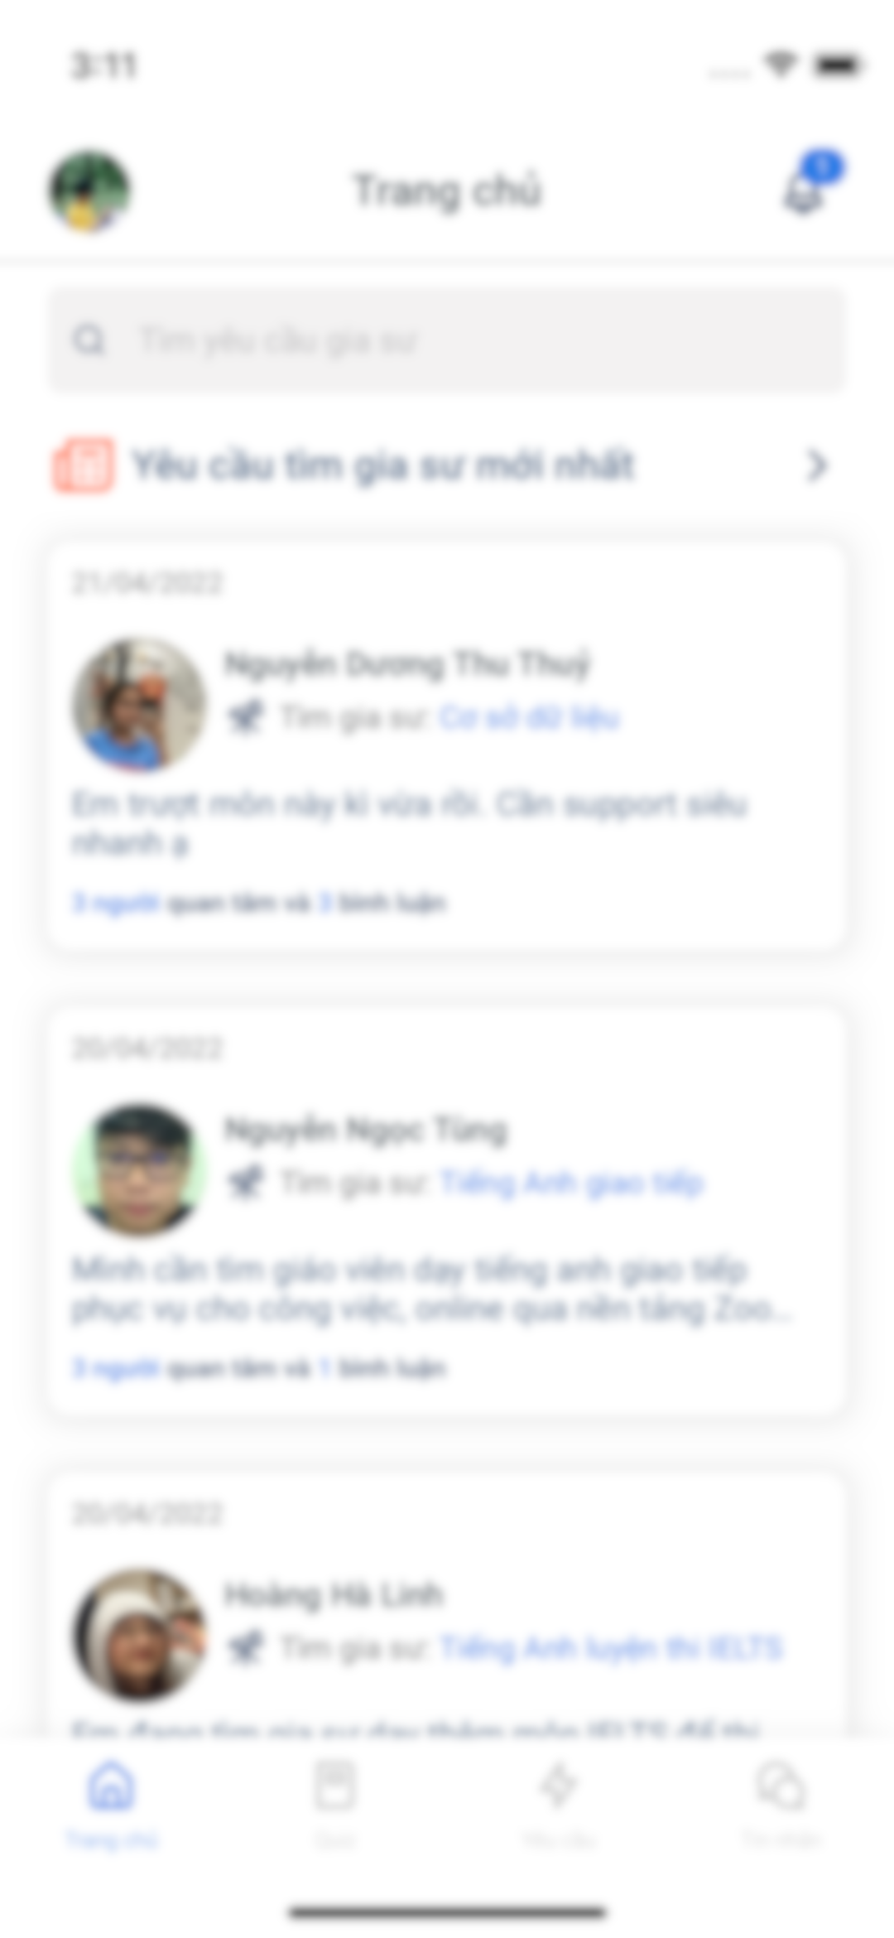
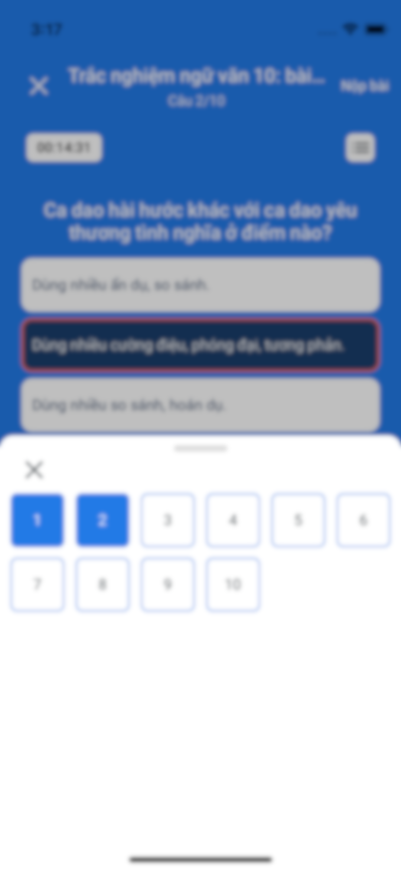
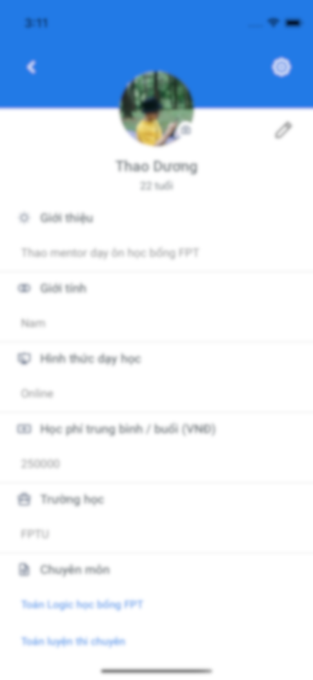
CAPSTONE PROJECT PRESENTATION
Tutor Finder Platform
Software Engineering, May 4th, 2022
Notes:
Lan

Slide 2


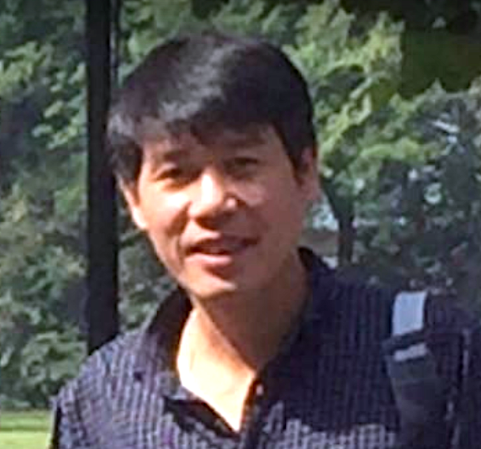



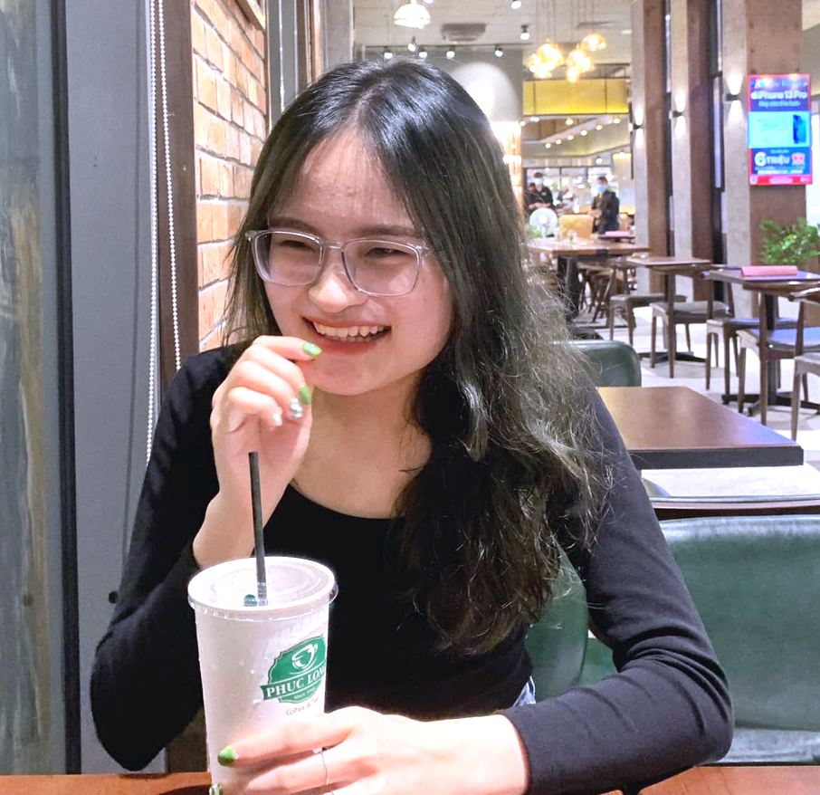

Pham Ngoc Duong
Supervisor
LABATE Team
Le Ngoc Lan
HE141730
PM
UI/UX
Nguyen Duong
Thu Thuy
HE140753
Mobile
UI/UX
Nguyen Hong Thuy
HE140997
Tester
Dinh Tuan Anh
HE141302
Backend
DevOps
Duong Minh Thao
HE141688
Backend
DevOps

Slide 3







PROJECT INTRODUCTION
PROJECT MANAGEMENT
SOFTWARE REQUIREMENT
SPECIFICATION
SOFTWARE DESIGN
SOFTWARE TESTING
LESSON LEARNED
– DEMO – Q&A

Slide 4

PROJECT
INTRODUCTION
Notes:
Thao

Slide 5

Notes:
Tass

Slide 6
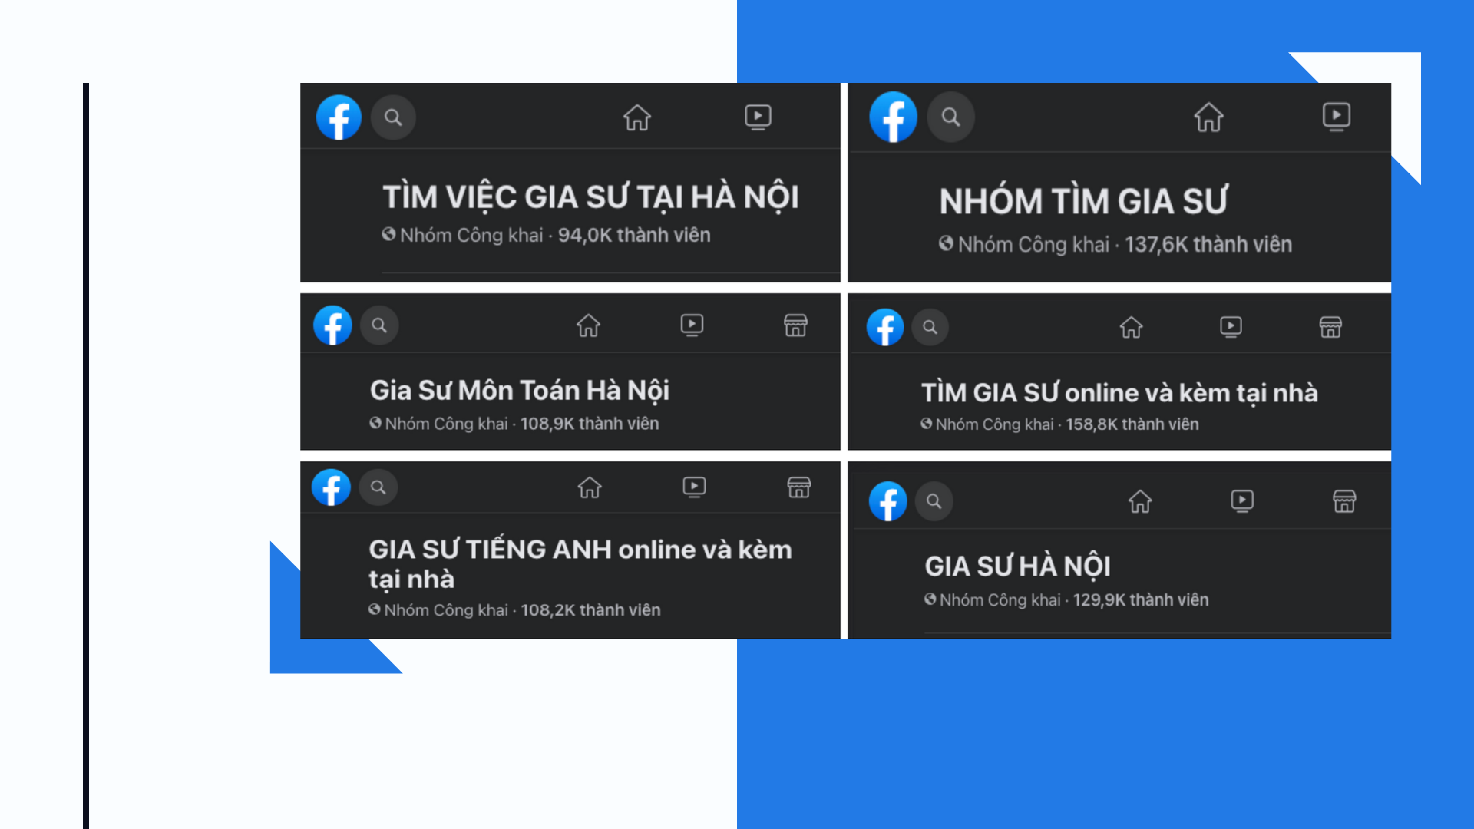

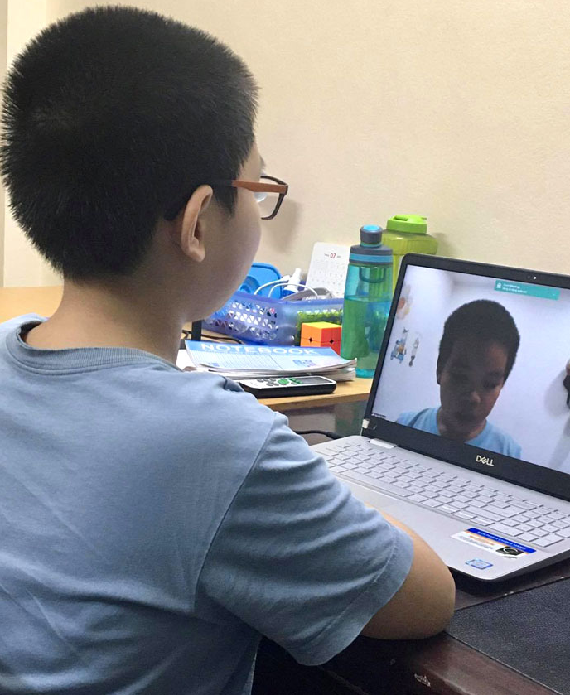
Figure 1.1. The demand for mentors is high. The tutoring groups on Facebook are very crowded.

Slide 9

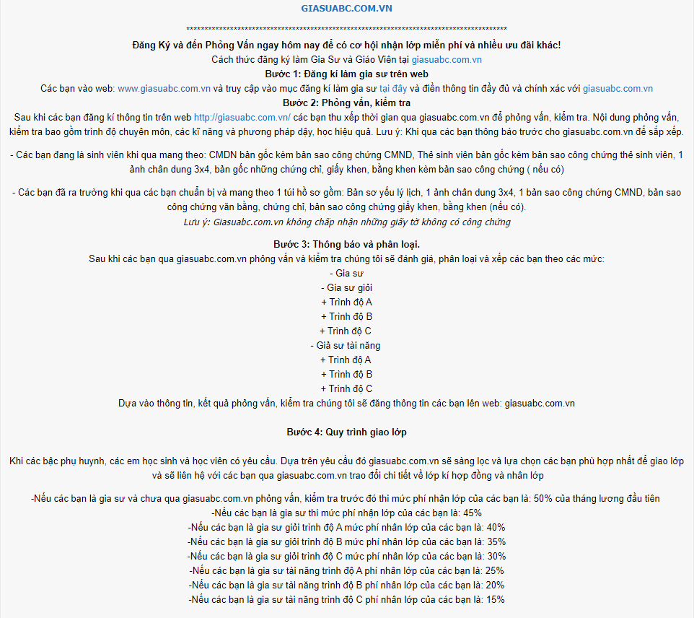

Slide 14
Figure 1.1. The demand for mentors is high. The tutoring groups on Facebook are very crowded.

Slide 15
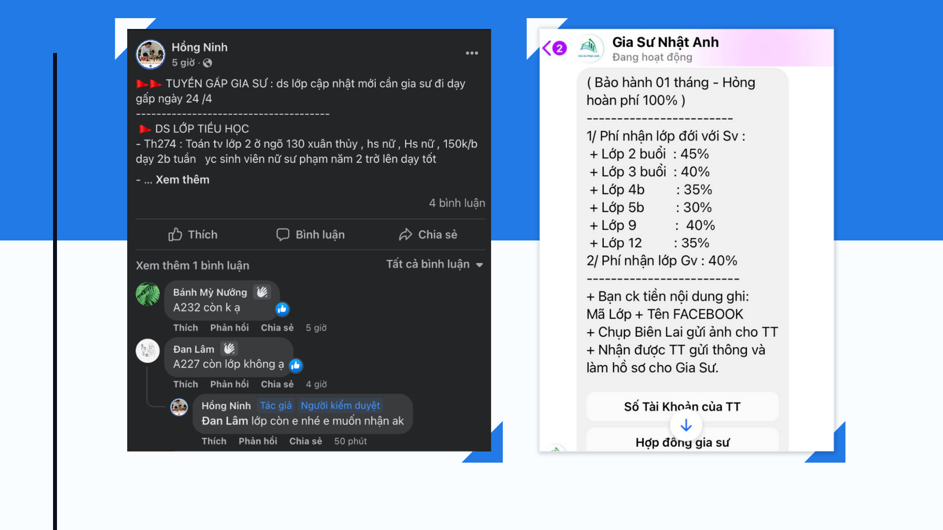
Figure 1.2. These tutoring groups all have to go through a brokerage center.
The mentor loses about half of the mentoring fee.

Slide 16



Existing System

Slide 17
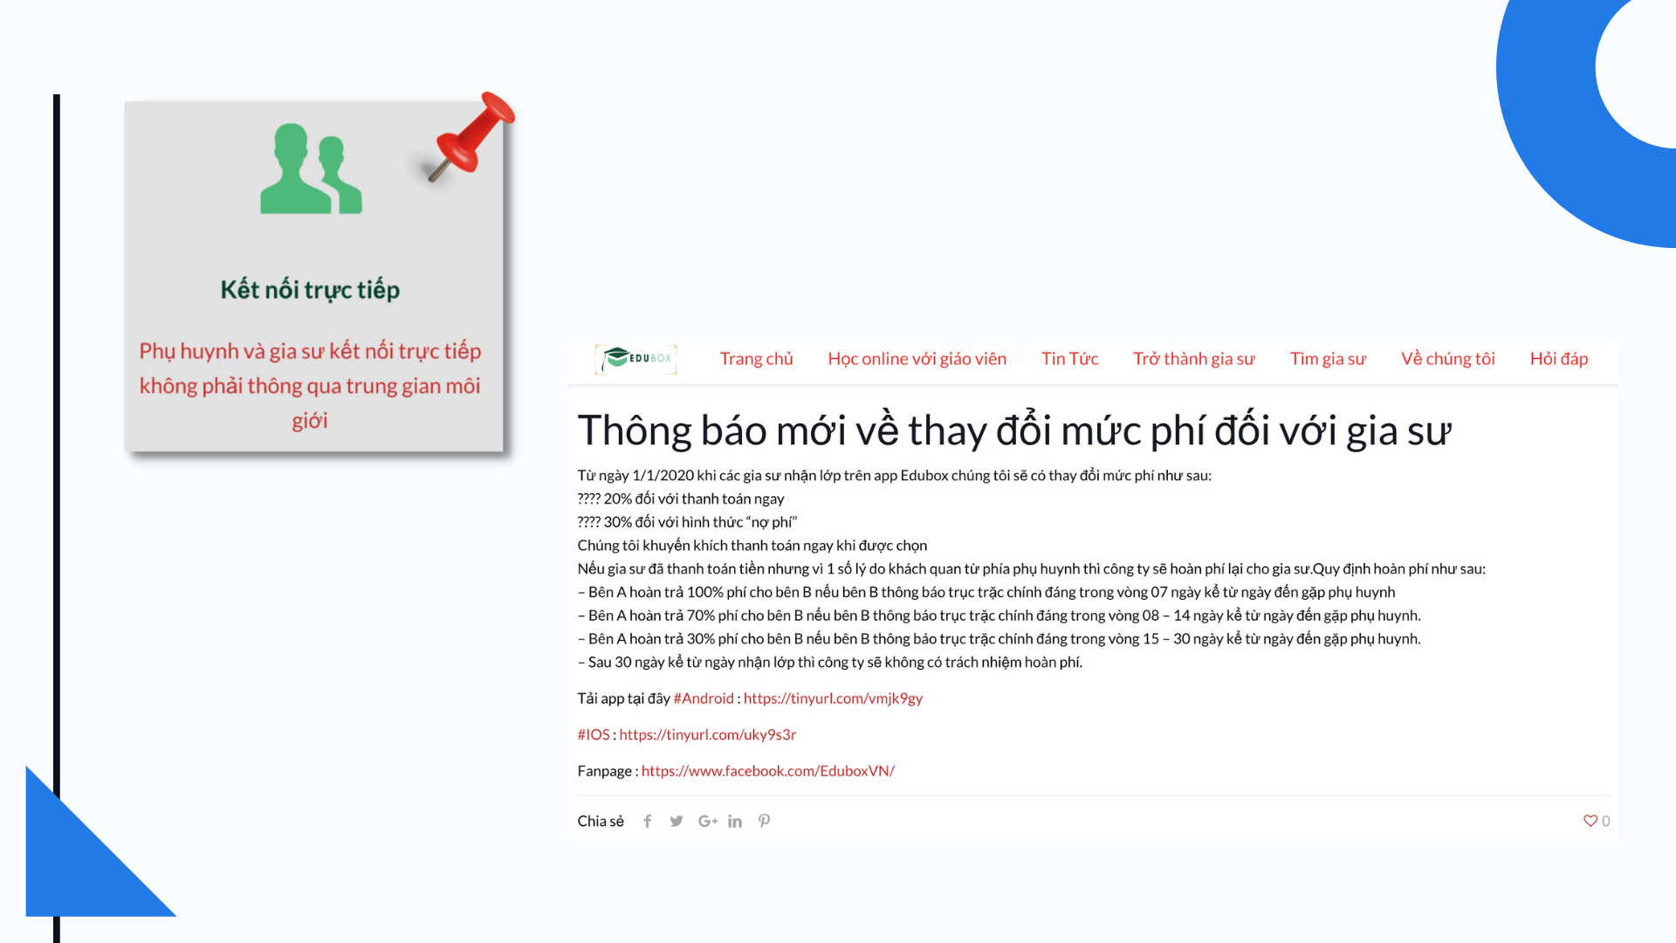
Figure 1.3. Although on the website, the EduBox app advertises the direct connection feature without a brokerage center, EduBox still has notice of collecting a mentoring fee.

Slide 18
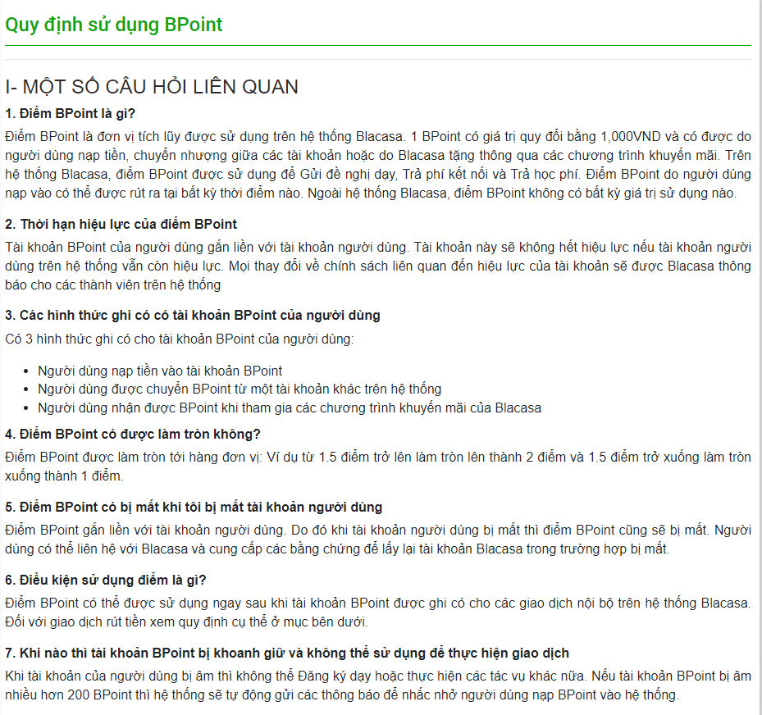

Slide 19






Background
Quickly, Conveniently, Quality Connection
Familiarity with Technology
Impact of Pandemic
Intermediary Tutor Center

Slide 20

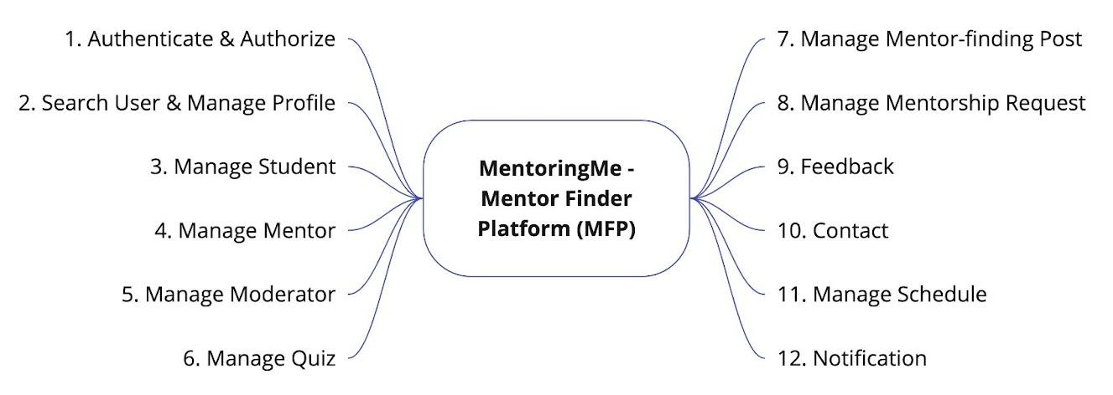
Scope

Slide 21






Feedback about students
Localization
Web & Android Version
Verification Tool
Limitation & Exclusion
Documentation Repository
Report User

Slide 22
PROJECT INTRODUCTION
PROJECT MANAGEMENT
SOFTWARE REQUIREMENT
SPECIFICATION
SOFTWARE DESIGN
SOFTWARE TESTING
LESSON LEARNED
– DEMO – Q&A

Slide 23
PROJECT MANAGEMENT

Slide 24

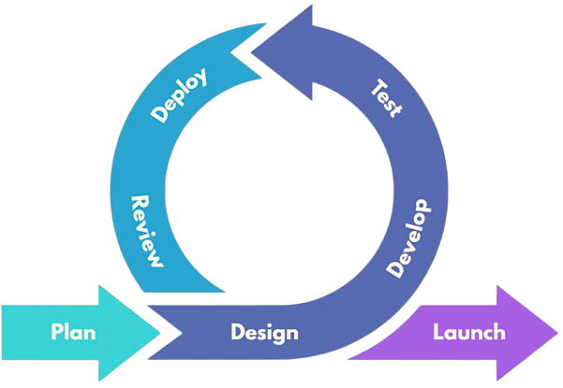
Agile Model
Process
Notes:
Lan: Existing Model, dự án bé tầm 3 tháng, k đủ effort, yêu cầu sp chưa rõ ràng từ ban đầu. Lặp từng phase pt 1, mỗi phase hoàn thiện background của sp hơn, sp hoàn thiện hơn sau từng phase.
Plan: req xuyên suốt quá trình, SRS khung
Vào mỗi phase sẽ có thay đổi yêu cầu vẽ chi tiết hơn
Mỗi phase dựa trên thay đổi SRS, rà soát lại bug của phase trc. Mỗi phase deploy ra 1 bản hoàn thiện với yêu cầu, và đưa cho khách hàng dùng acceptance test
3 phase

Slide 25
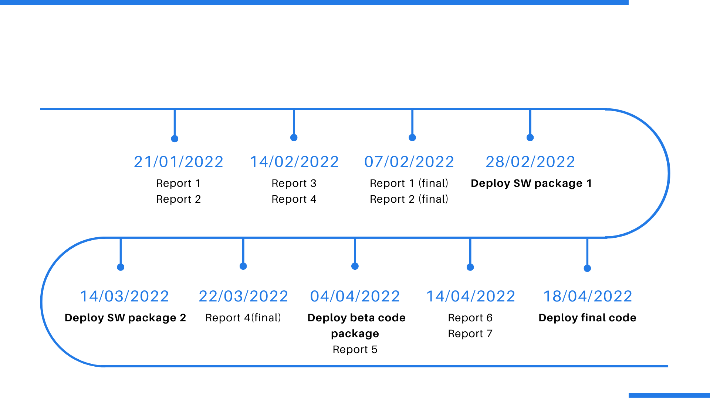
Delivery Milestones

Slide 26






Impact: ▲; Possibility: ▲
Impact: ▲; Possibility: ▲
Impact: ▲; Possibility: ▼
Requirement changes
Illness/absence of member
Conflict among member
Impact: ◉; Possibility: ◉
Impact: ▲; Possibility: ◉
Member distraction
Lack of skill & technology knowledge
Risk Management
Notes:
LAN

Slide 27
PROJECT INTRODUCTION
PROJECT MANAGEMENT
SOFTWARE REQUIREMENT
SPECIFICATION
SOFTWARE DESIGN
SOFTWARE TESTING
LESSON LEARNED
– DEMO – Q&A
Notes:
LAN

Slide 28
SOFTWARE REQUIREMENT
SPECIFICATION

Slide 29
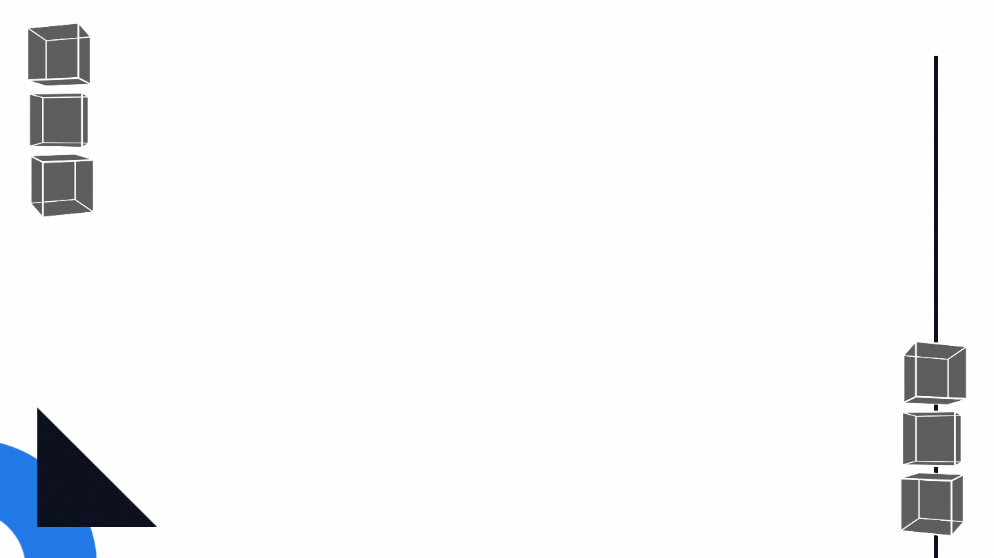
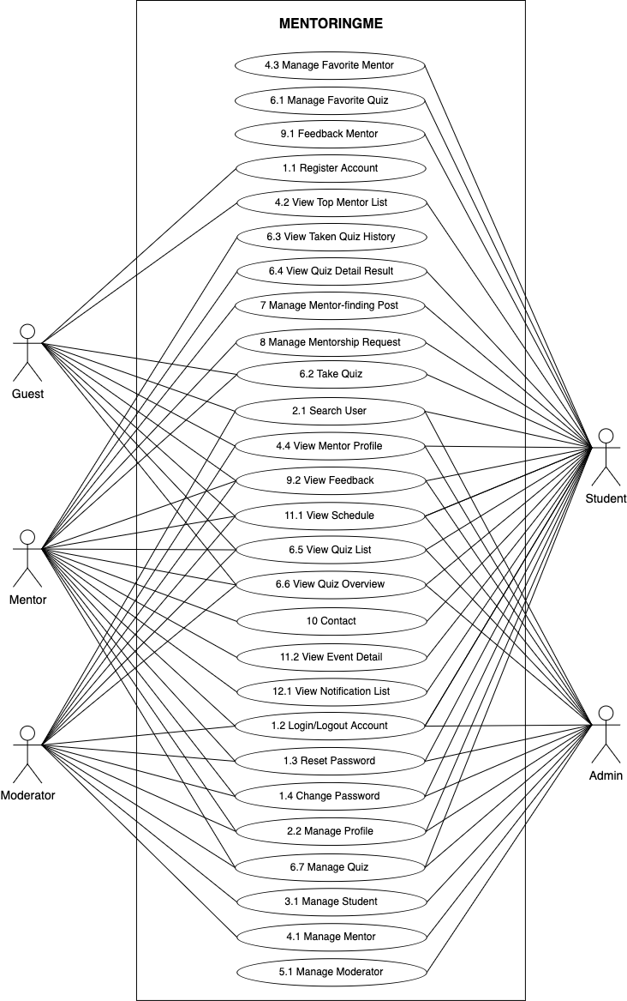
Use Cases
9
Guest
28
Moderator
70
32
Admin
39
Mentor
47
Student

Slide 30

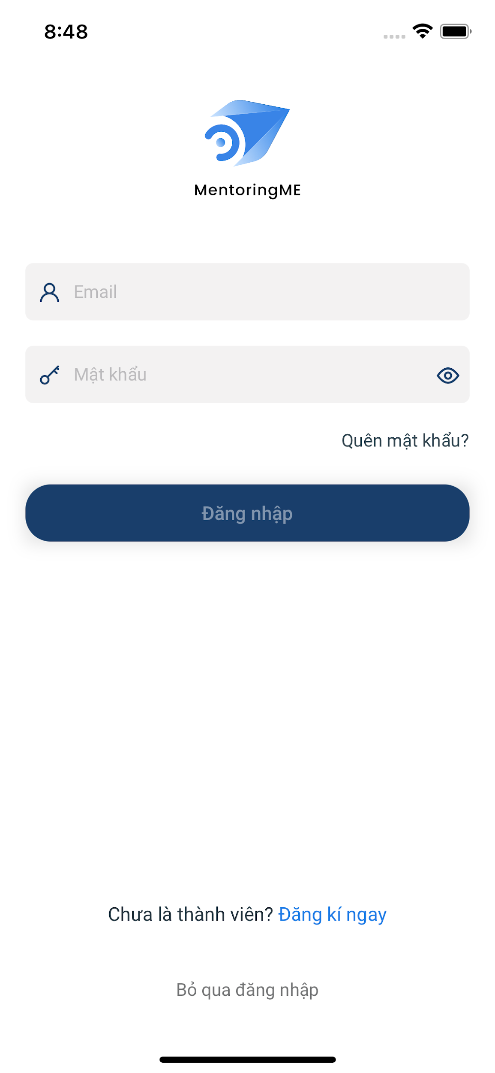
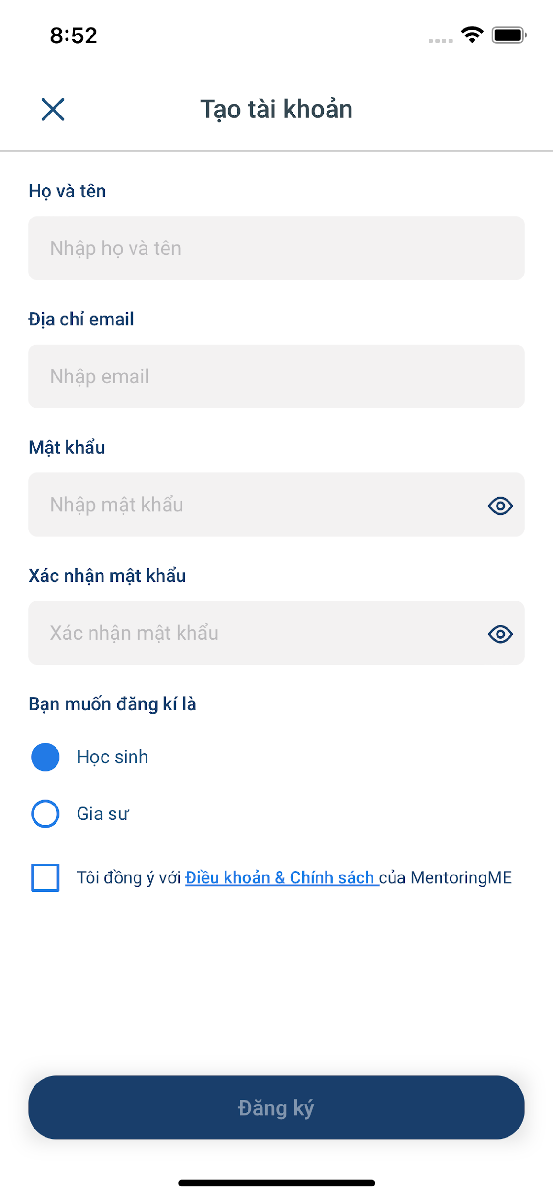
Guest
Register Account
Take Quiz
View Mentor Profile

Slide 31
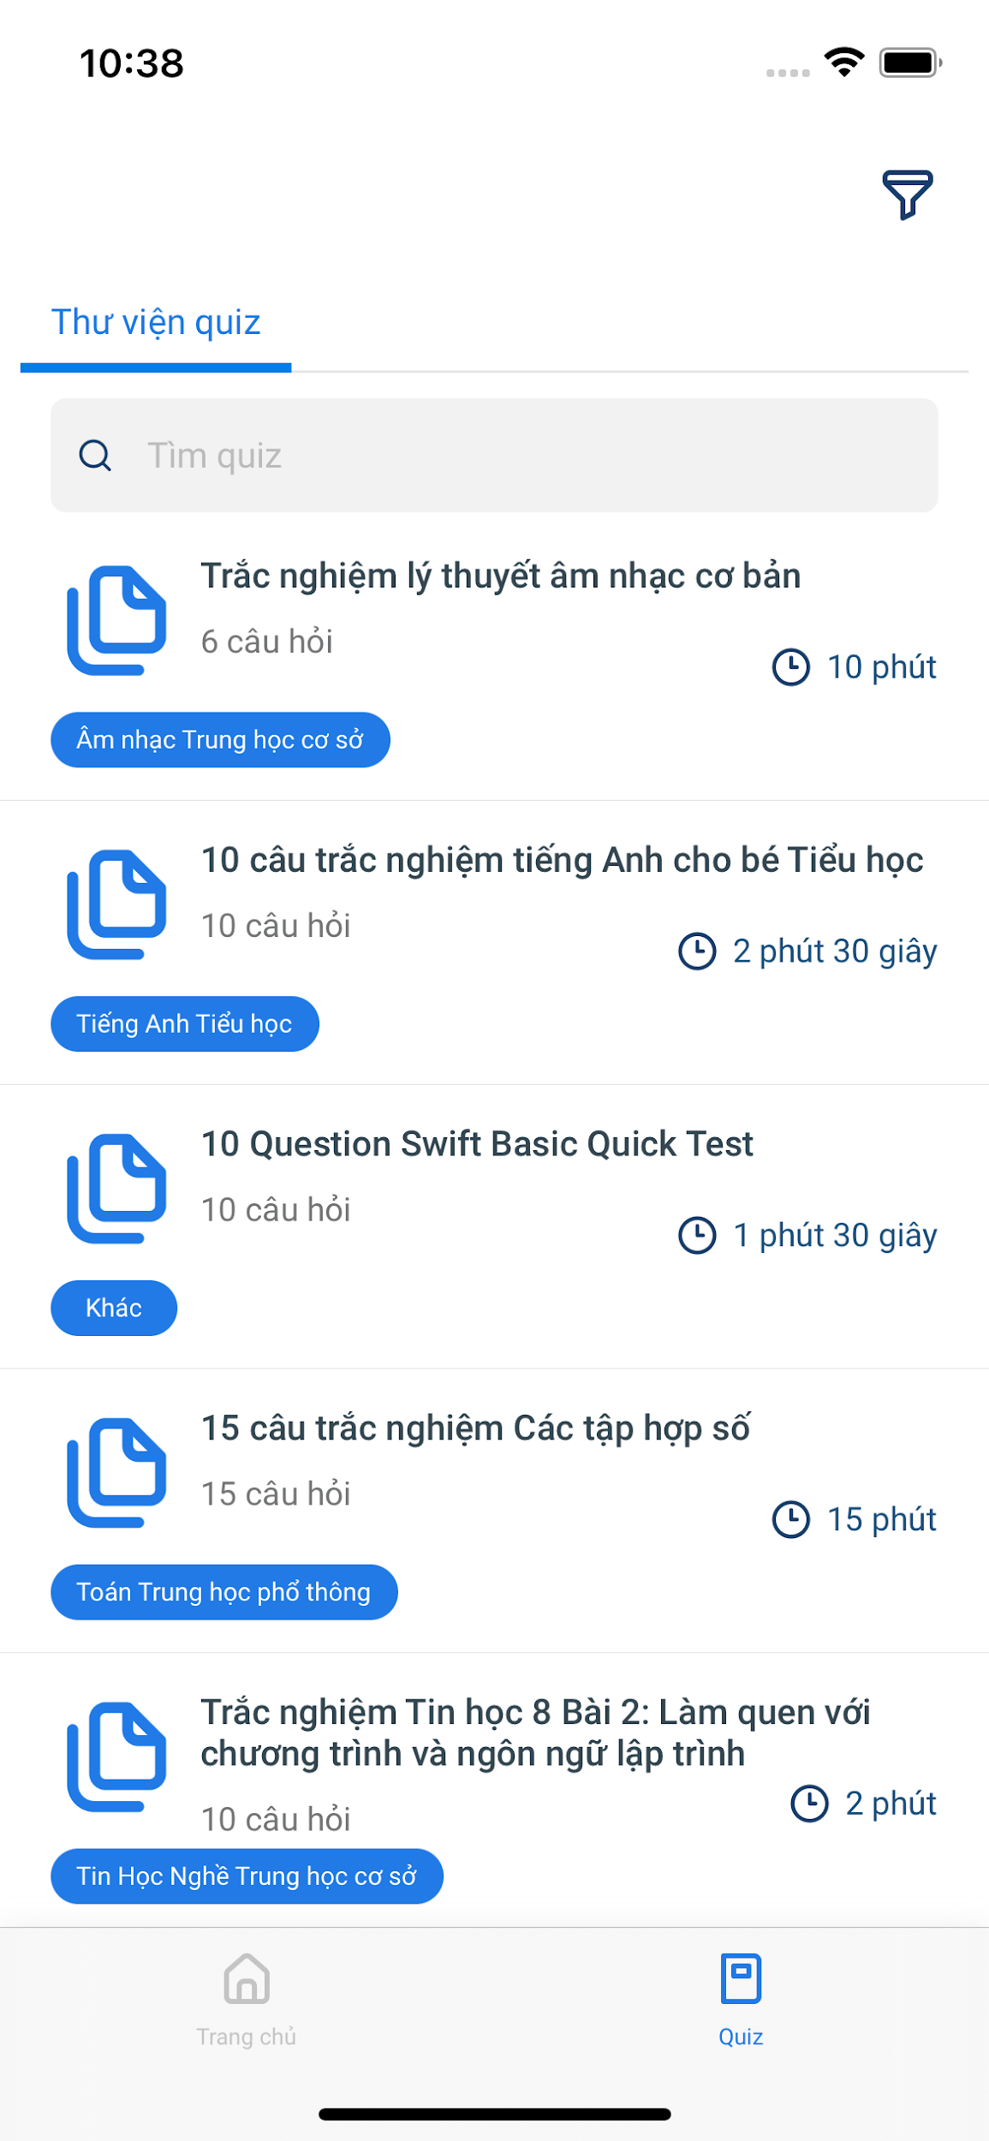
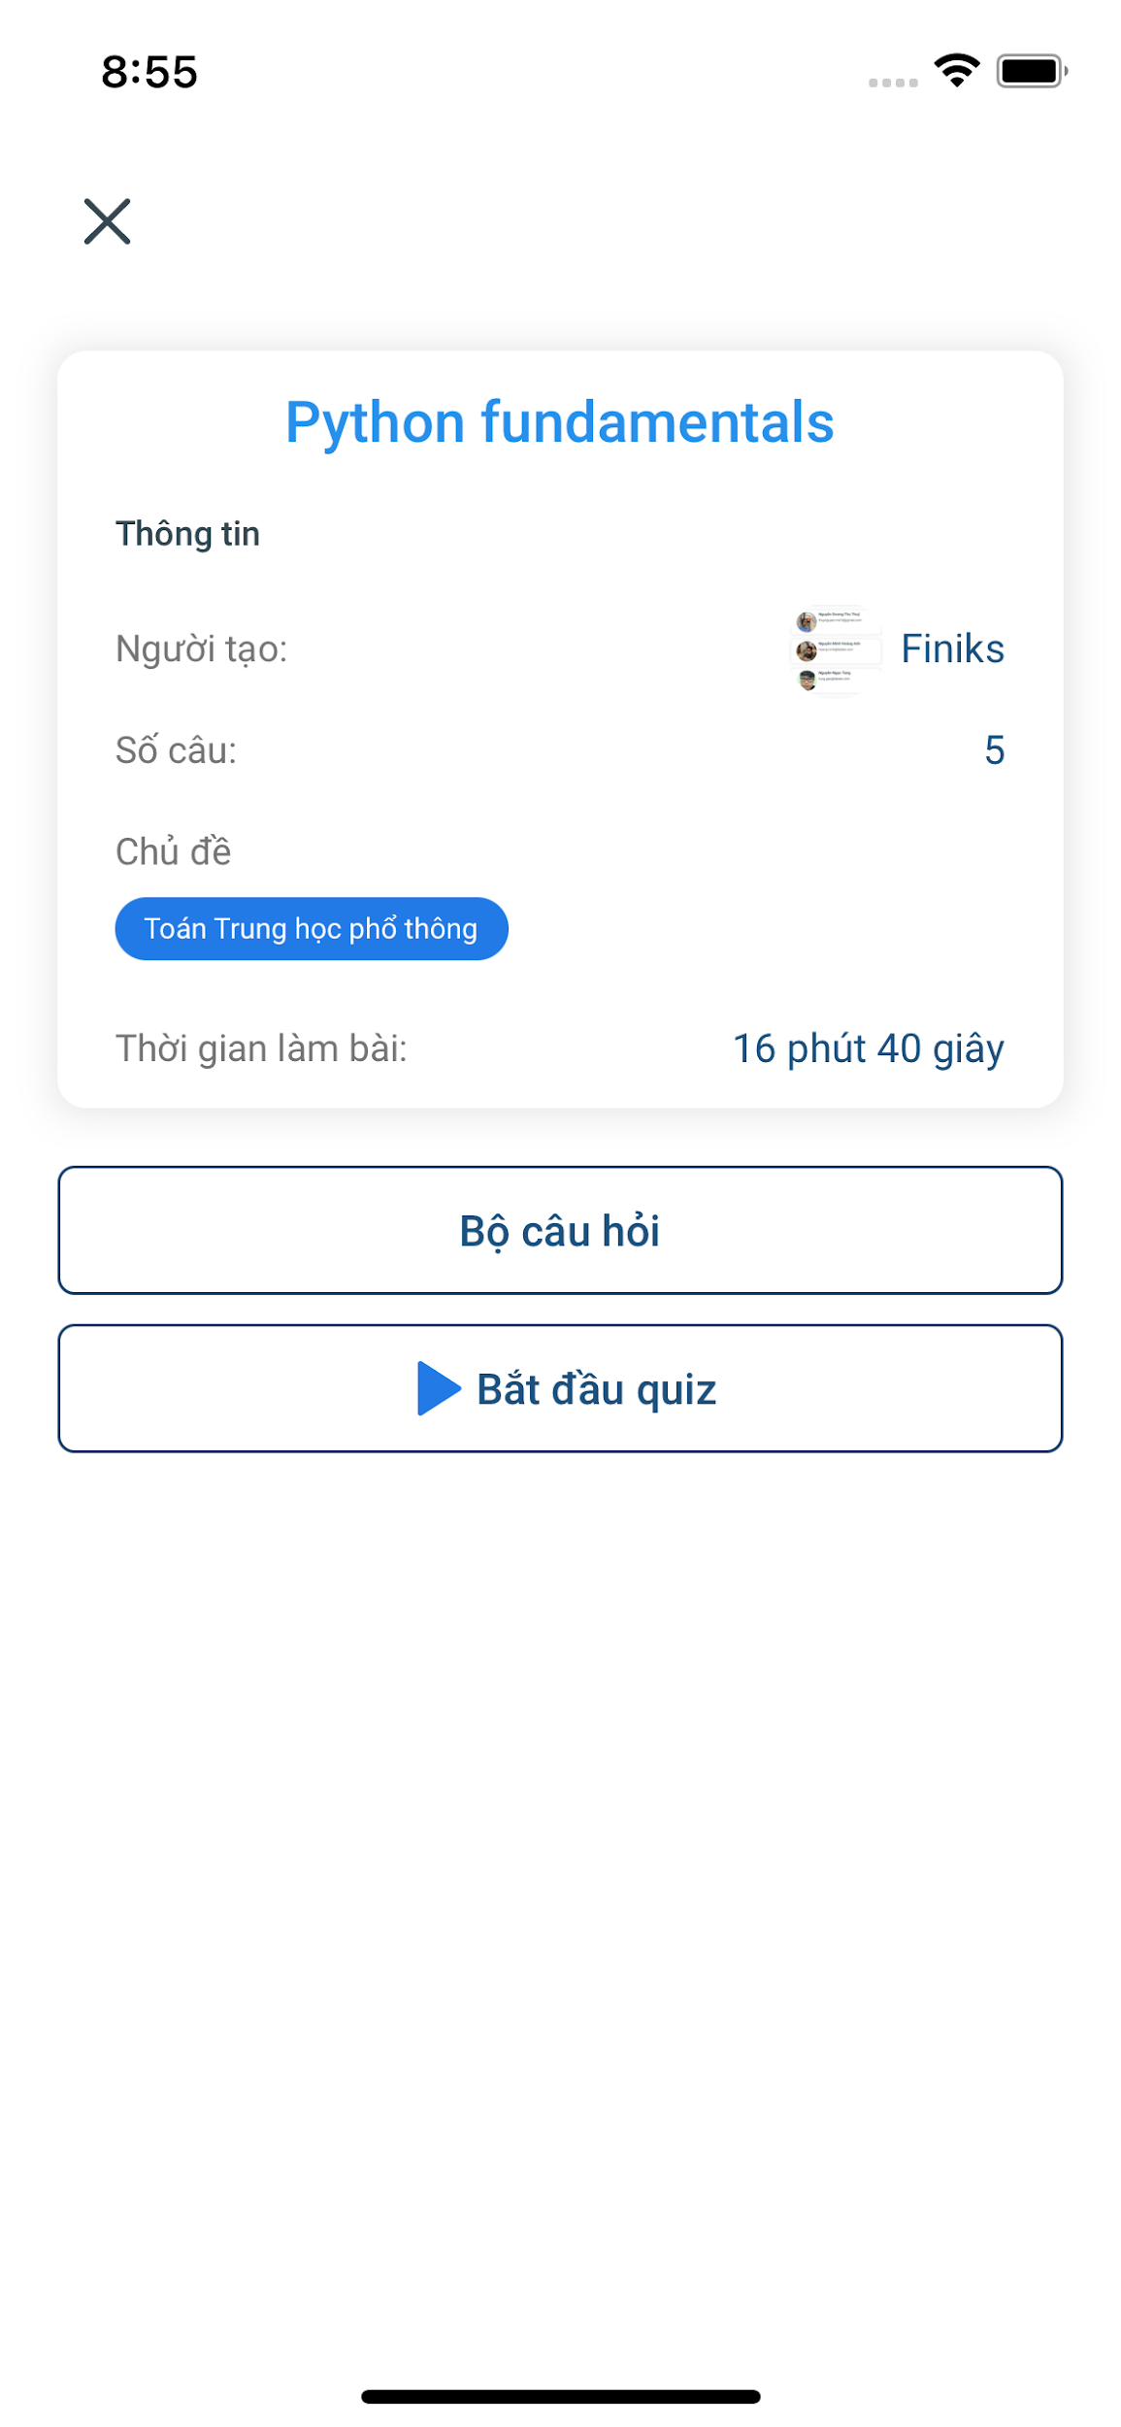
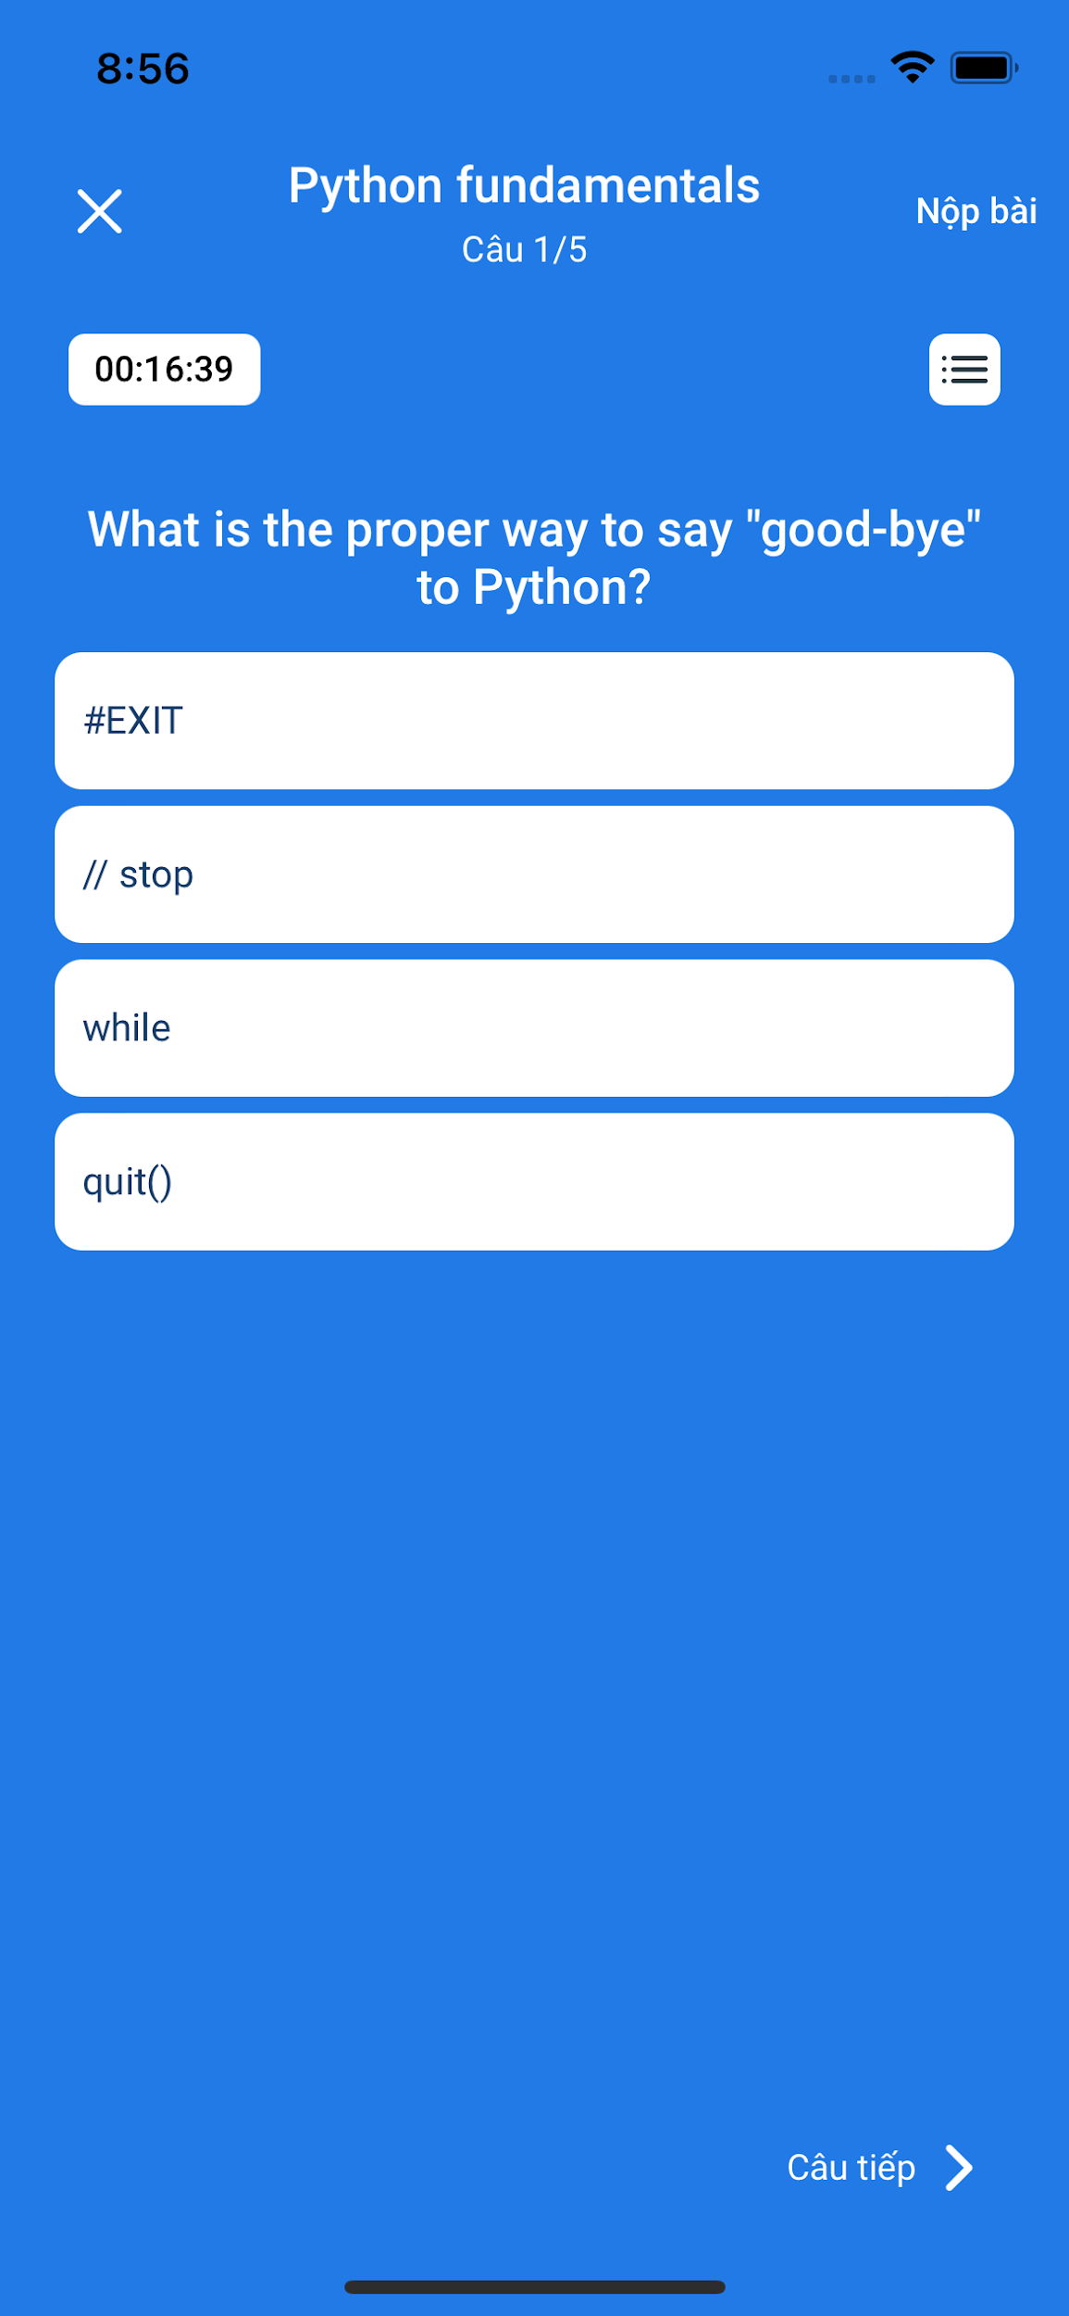
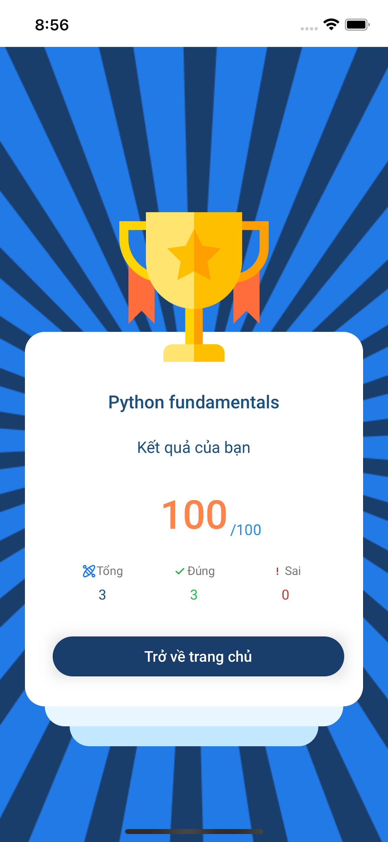
Guest
Register Account
Take Quiz
View Mentor Profile

Slide 32
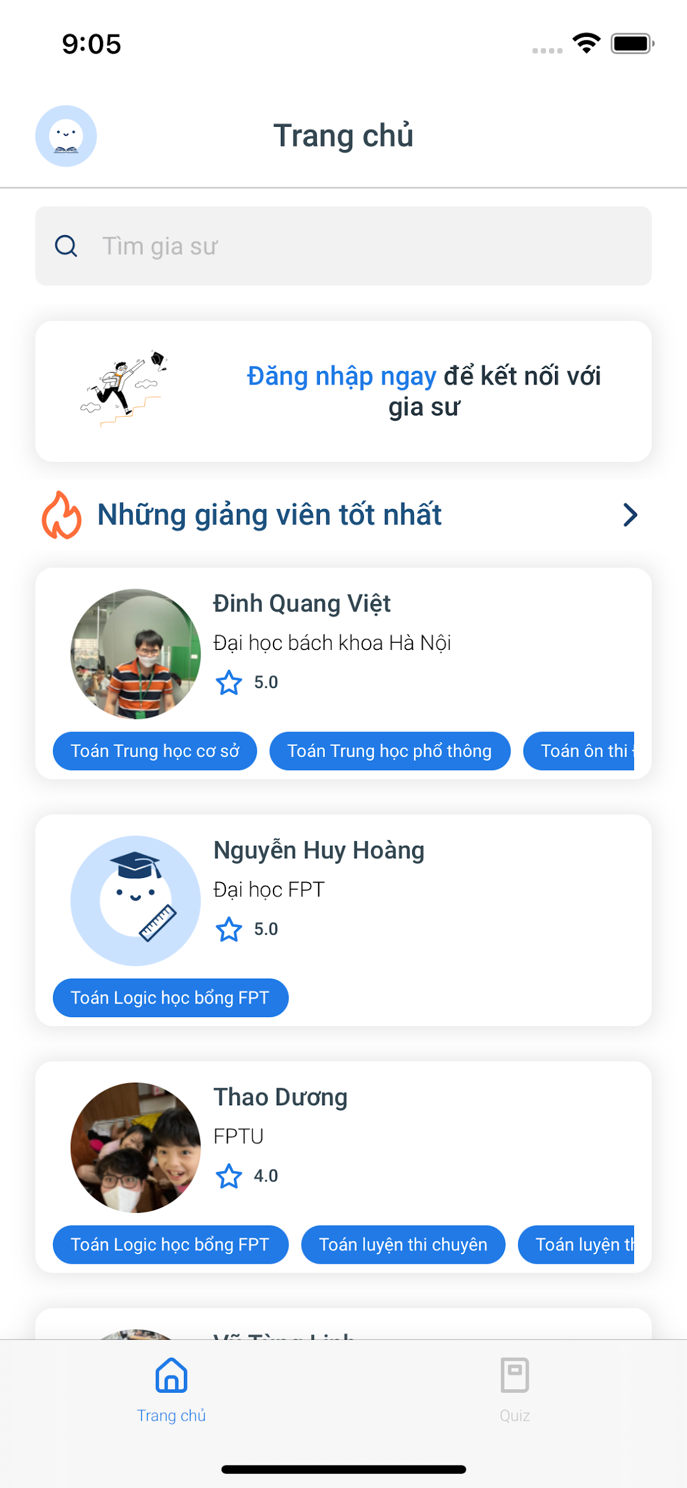
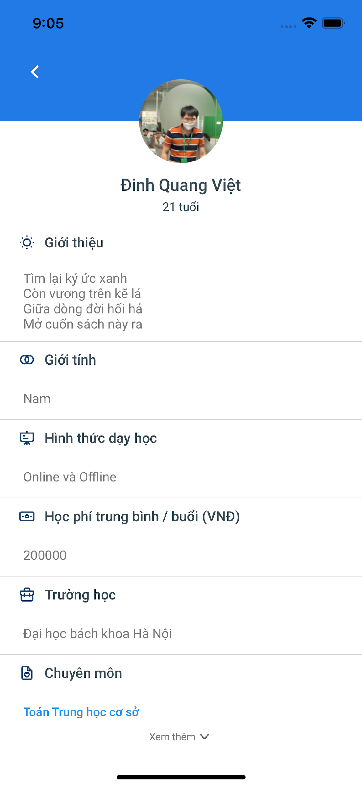
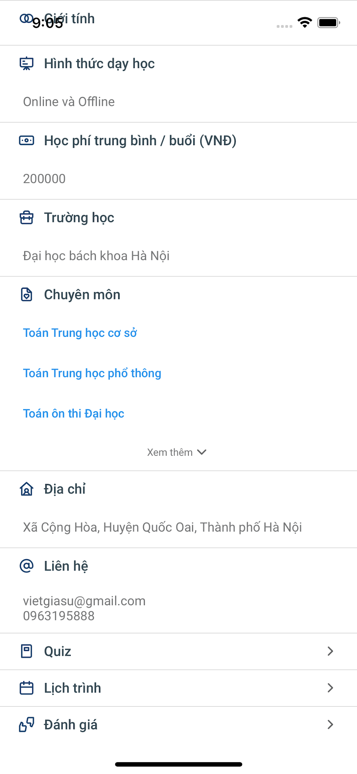
Guest
Register Account
Take Quiz
View Mentor Profile

Slide 33
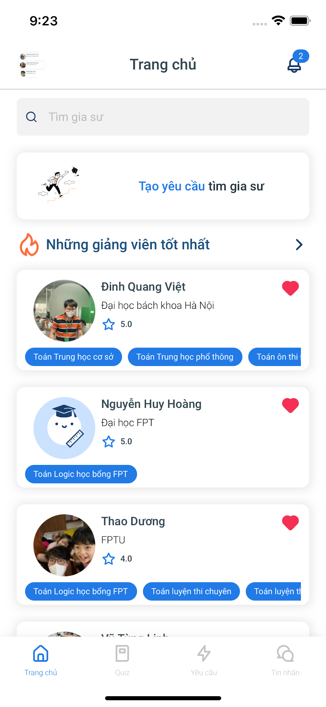
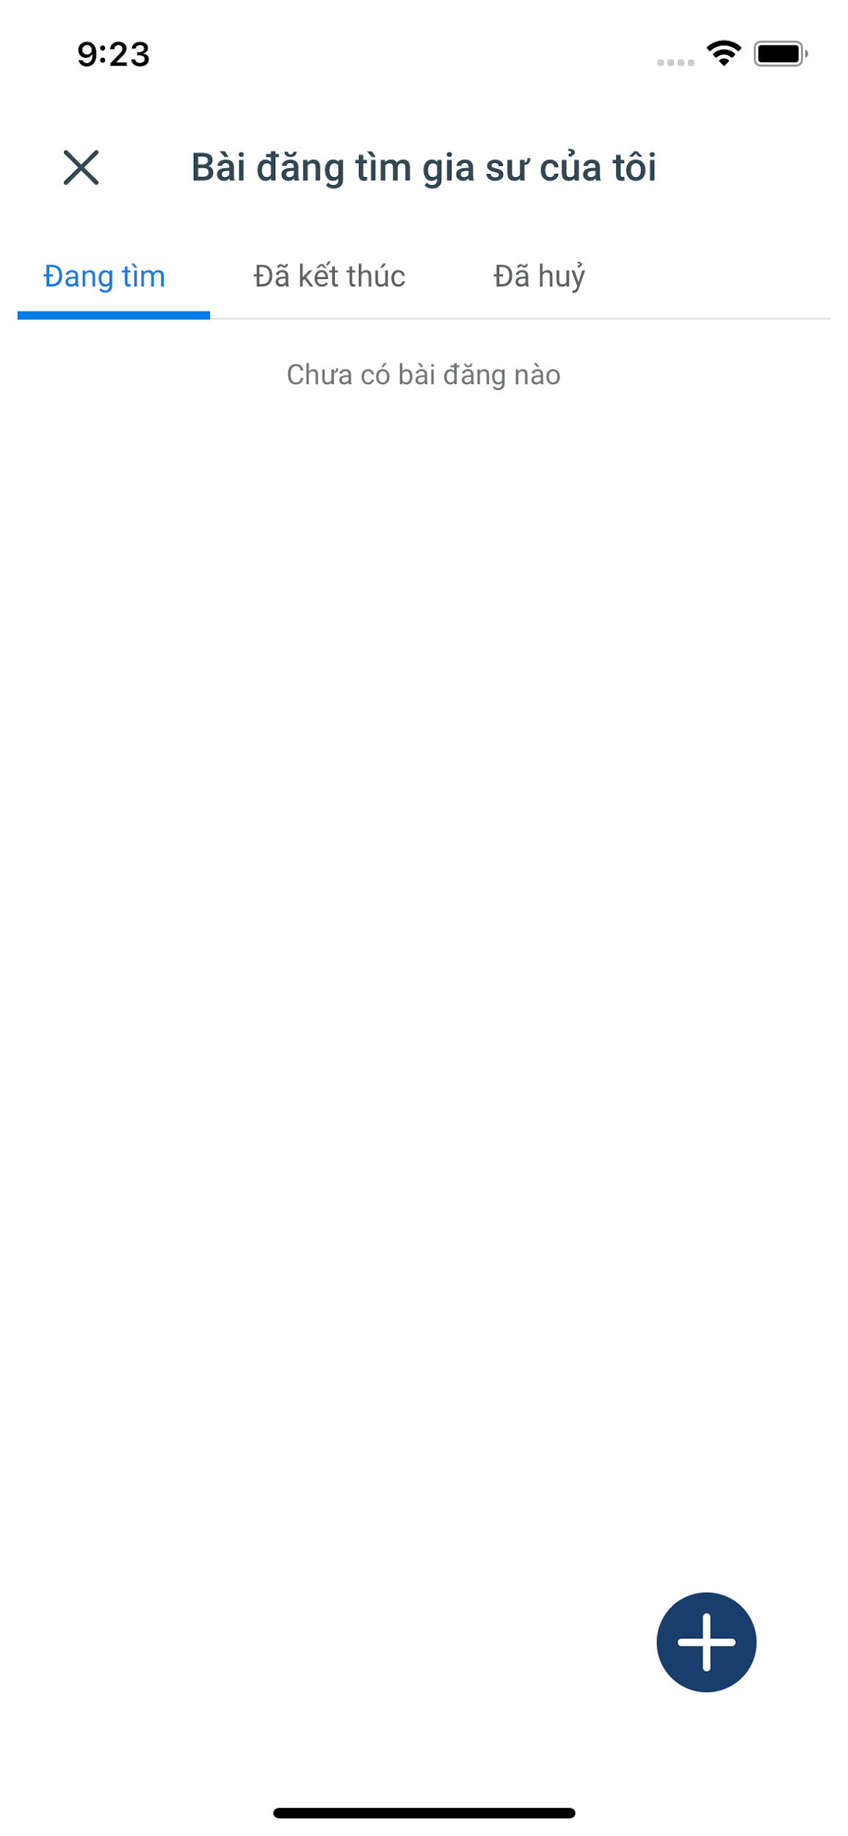
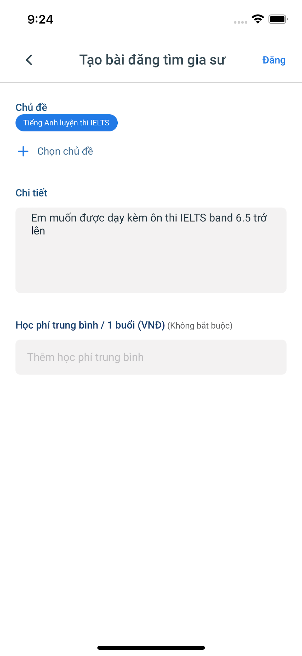
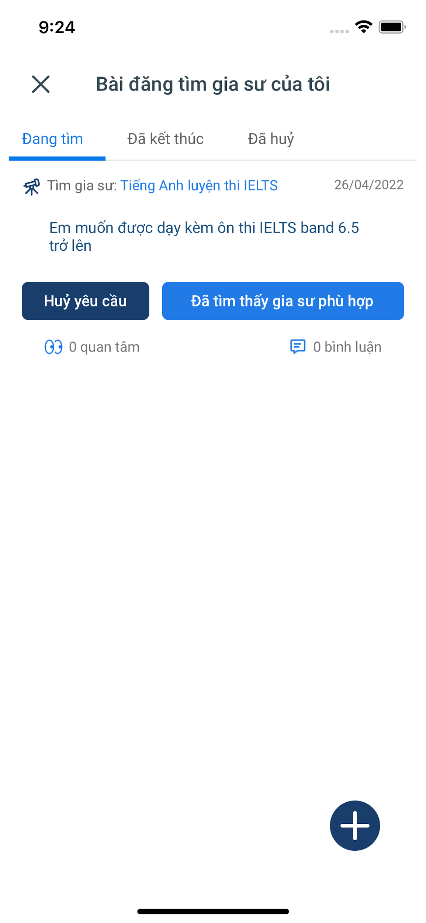
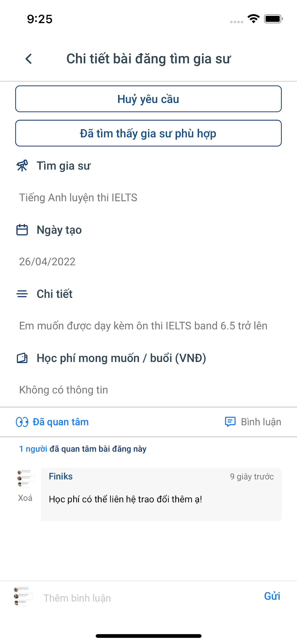
Student
Manage Mentors-finding Post
View Mentor Profile
Contact
Manage Mentorship Request
View Notification List
View Schedule
Take Quiz
Feedback Mentor

Slide 34

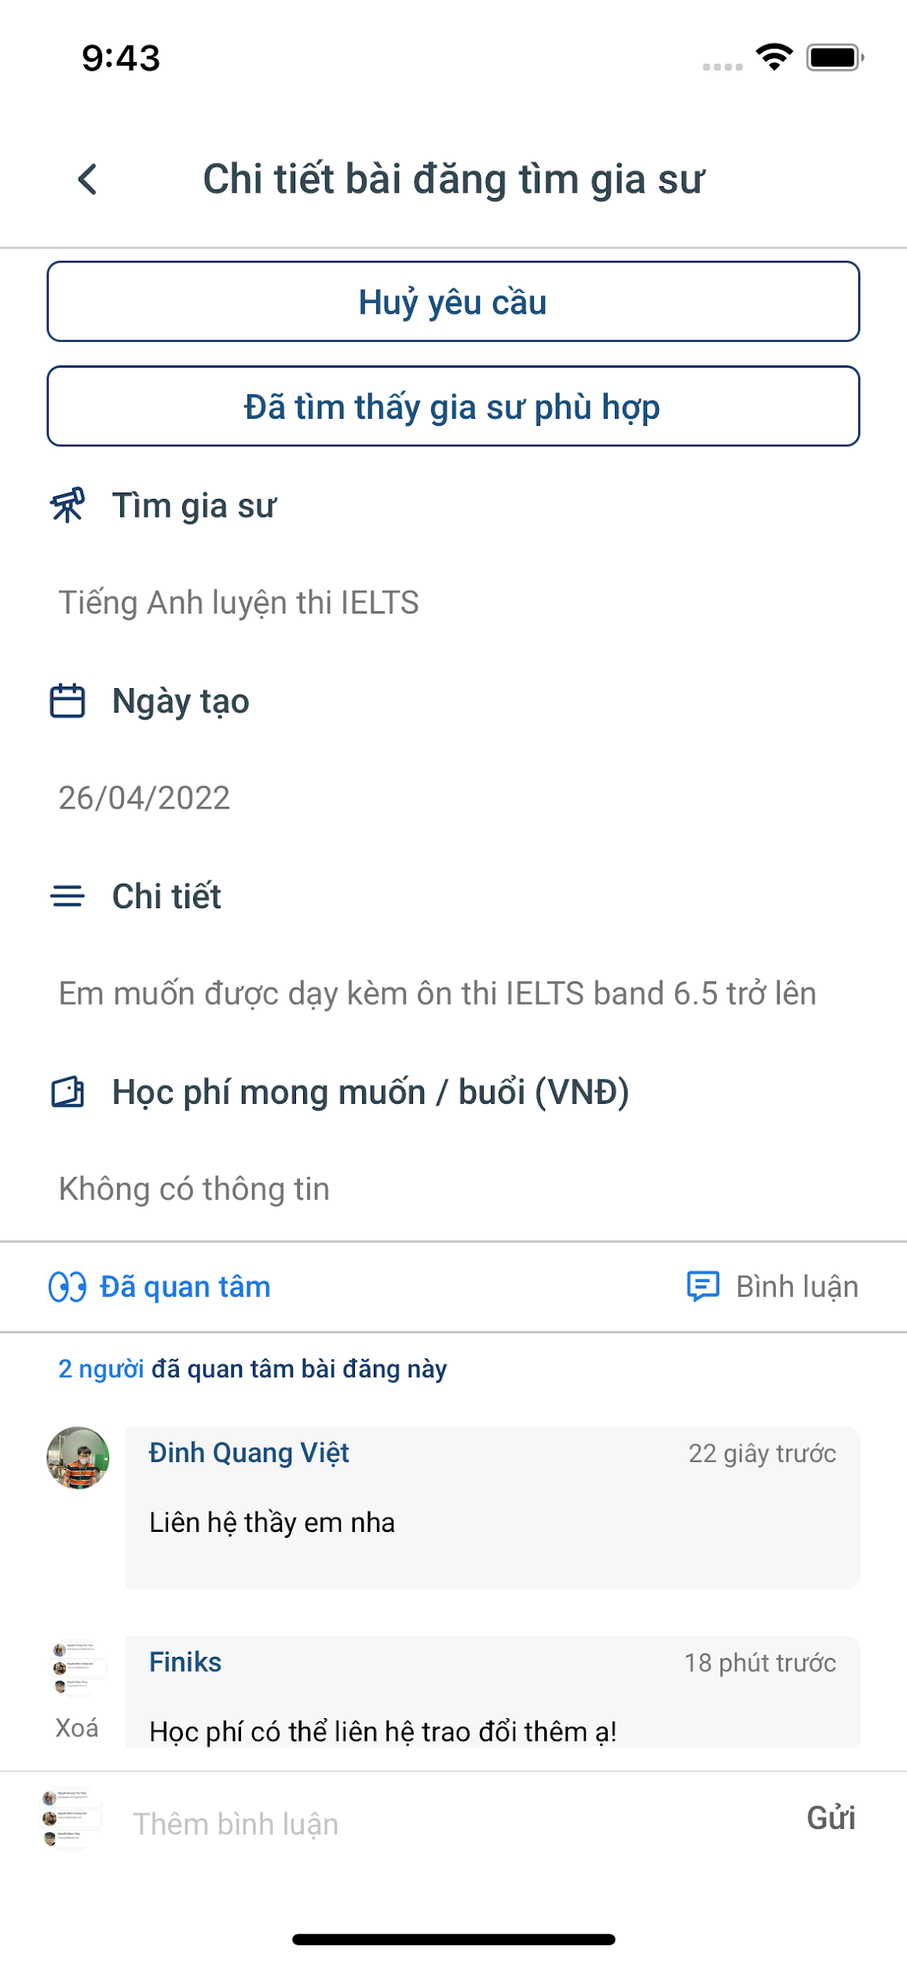
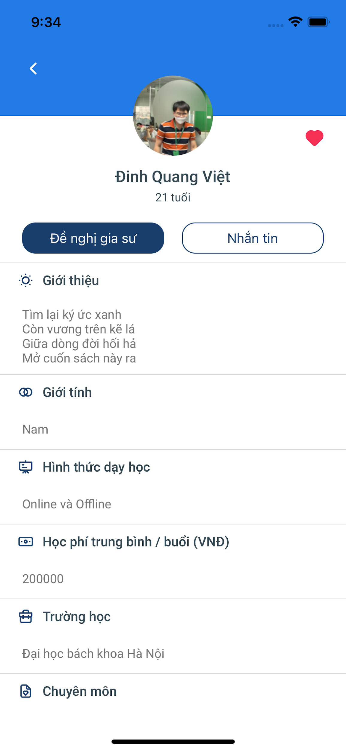
Student
Manage Mentors-finding Post
View Mentor Profile
Contact
Manage Mentorship Request
View Notification List
View Schedule
Take Quiz
Feedback Mentor

Slide 35
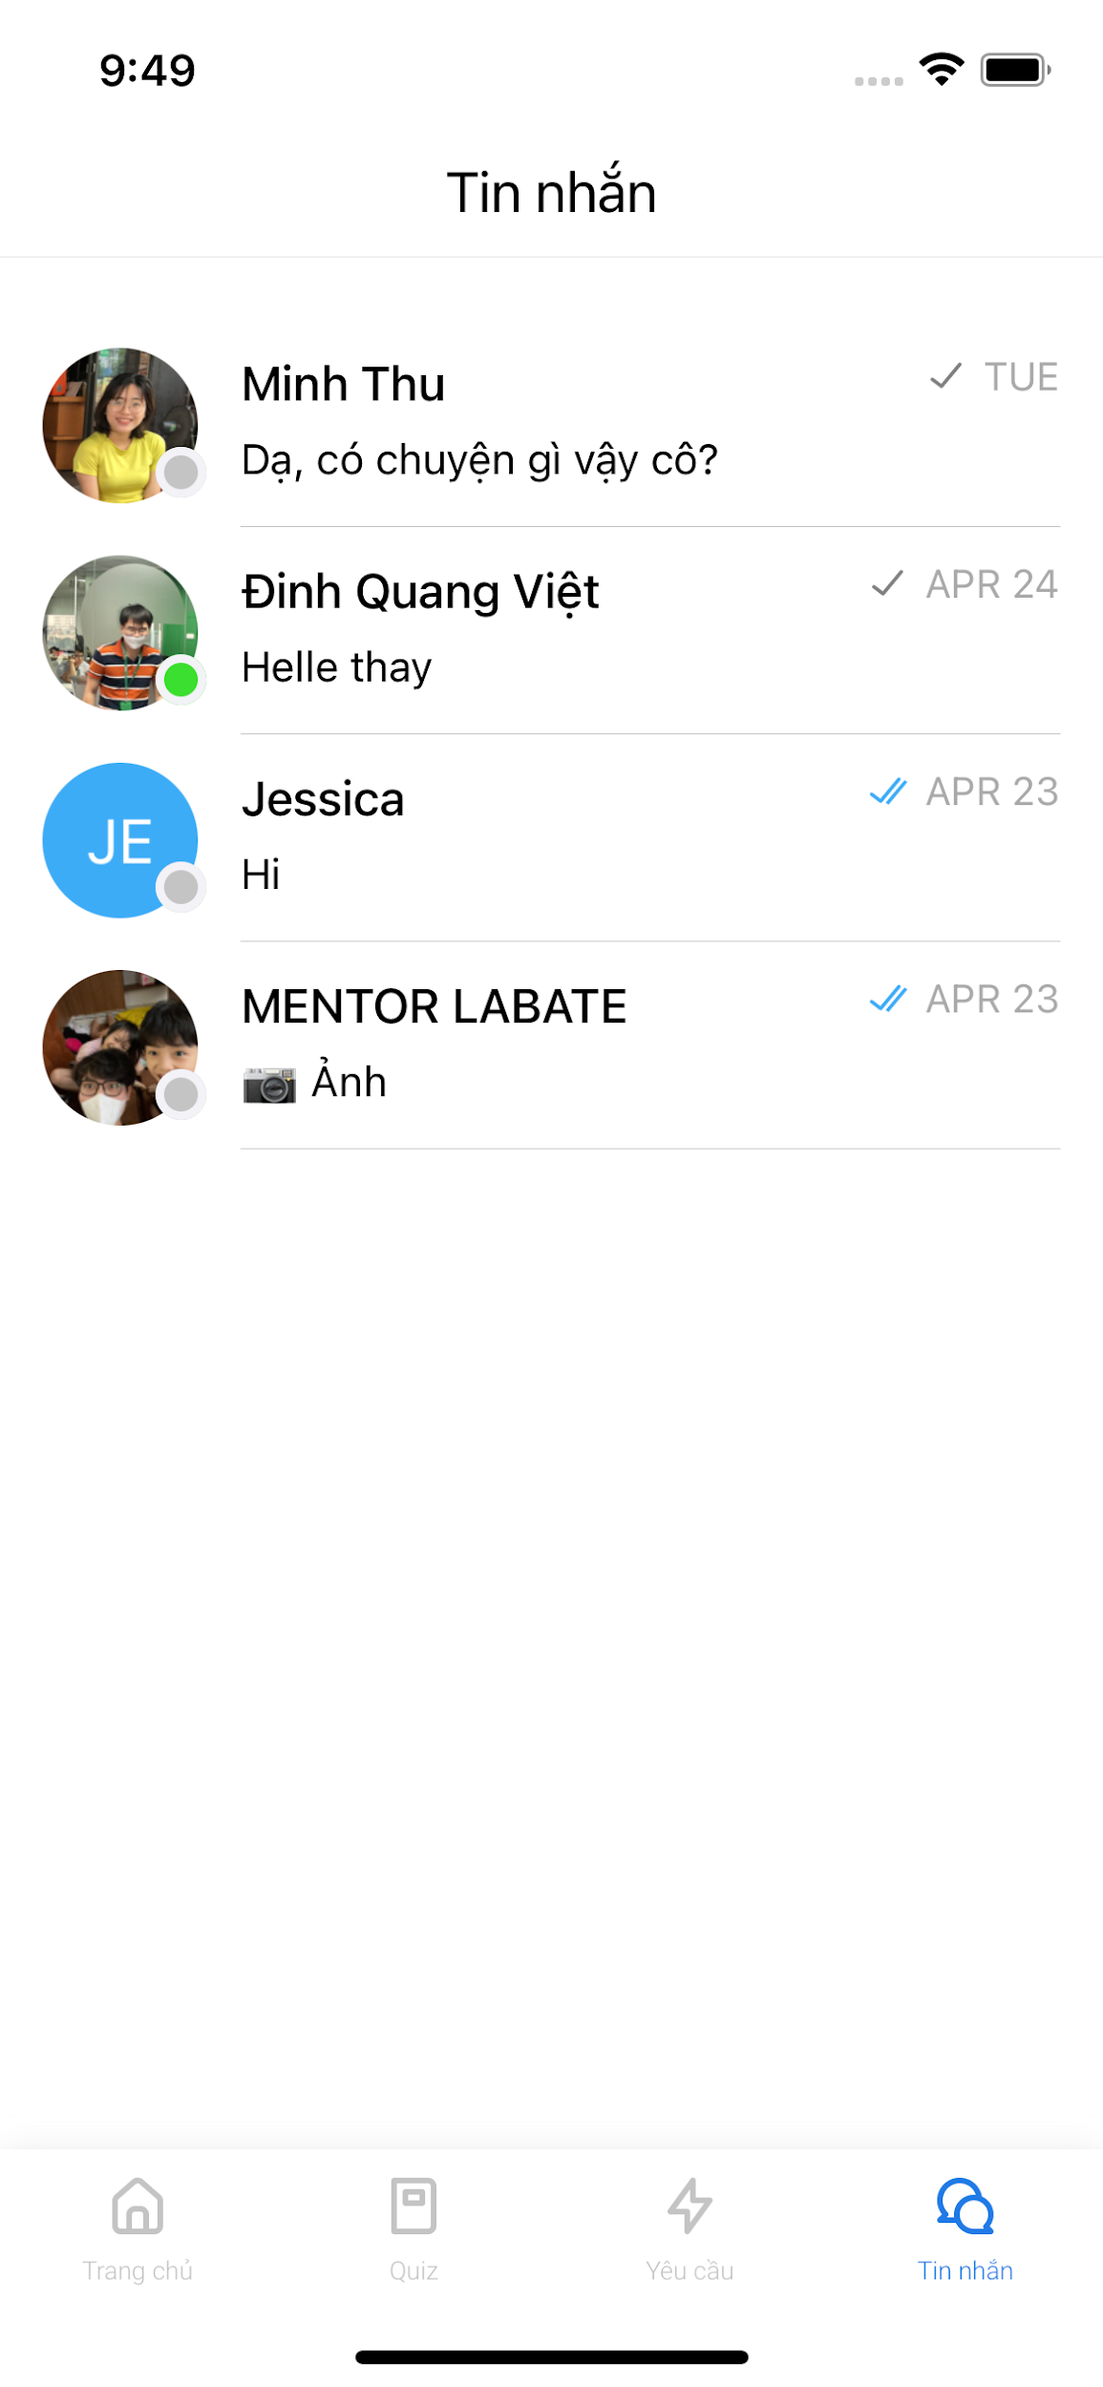
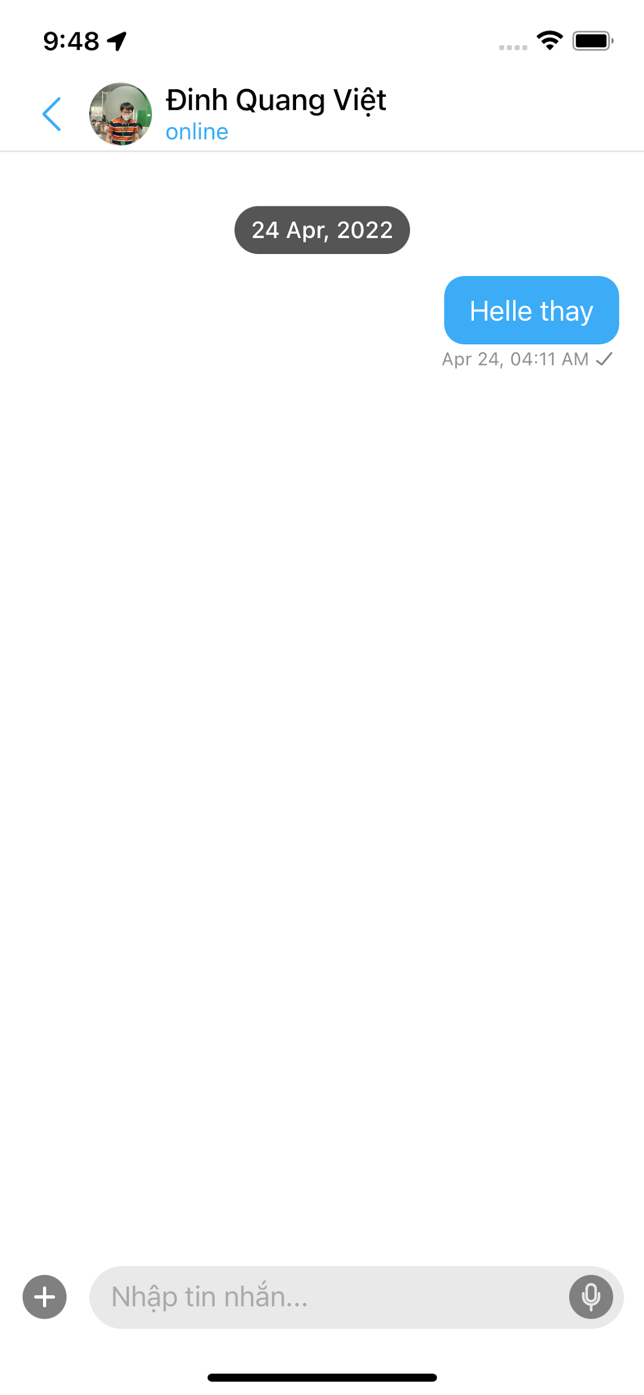
Student
Manage Mentors-finding Post
View Mentor Profile
Contact
Manage Mentorship Request
View Notification List
View Schedule
Take Quiz
Feedback Mentor

Slide 36
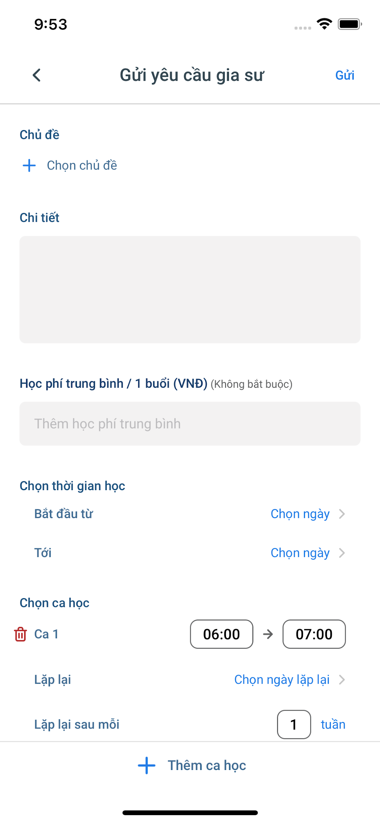
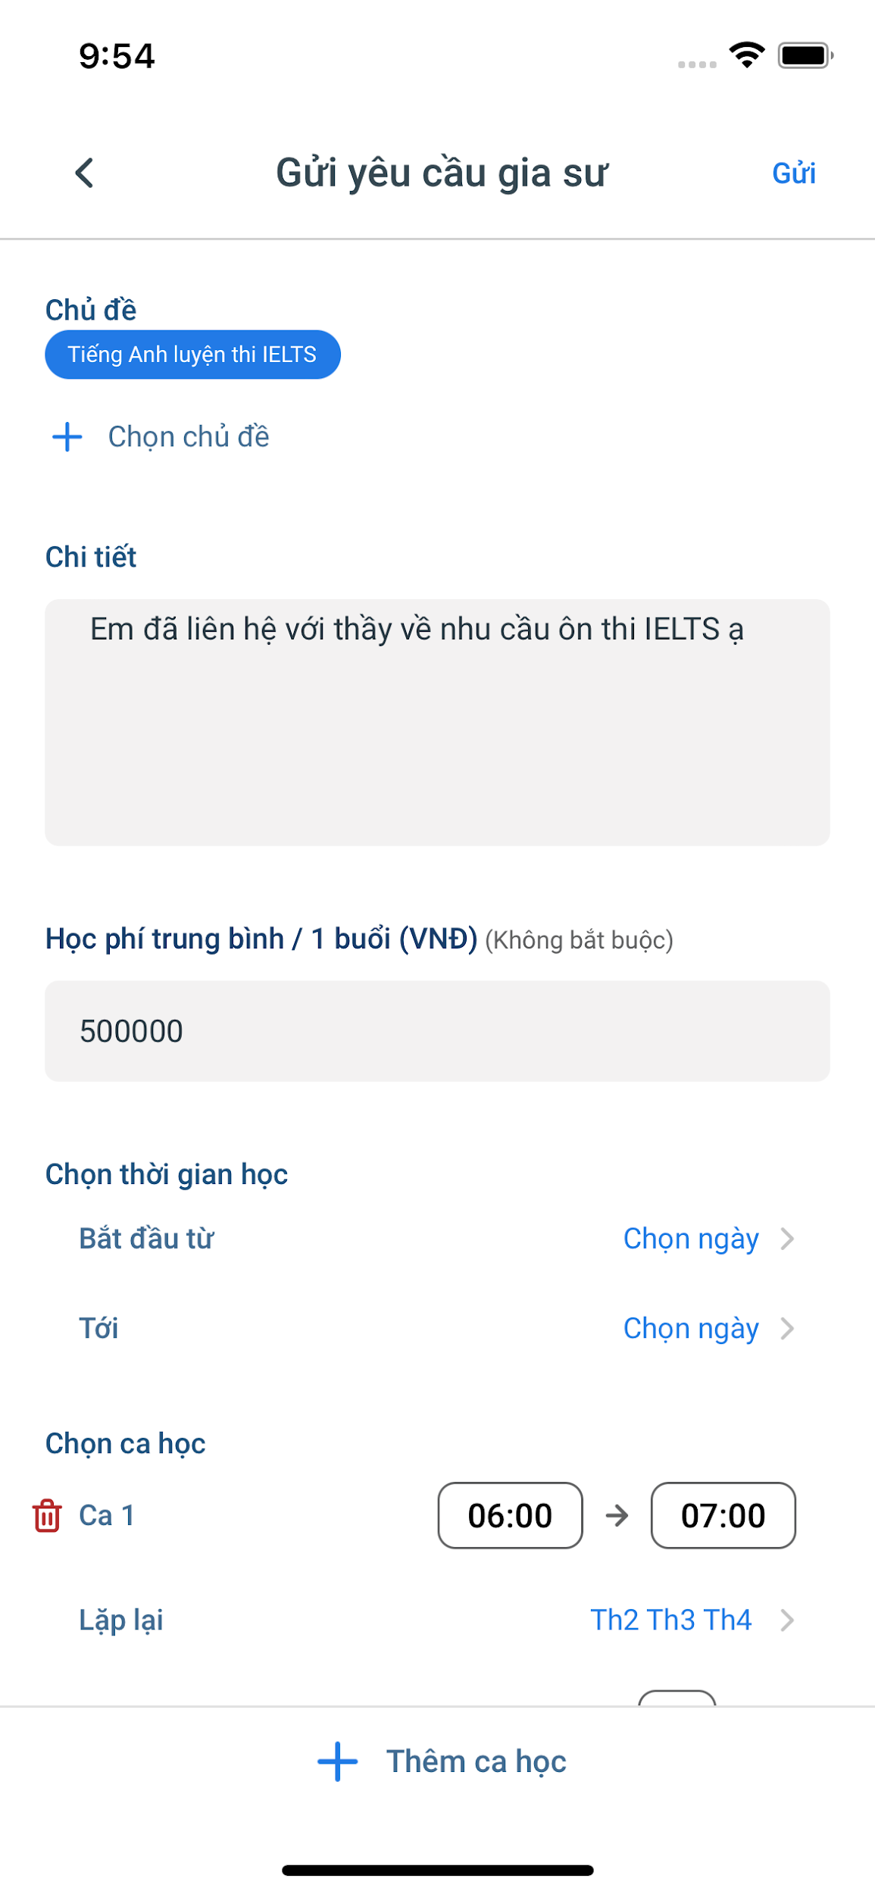
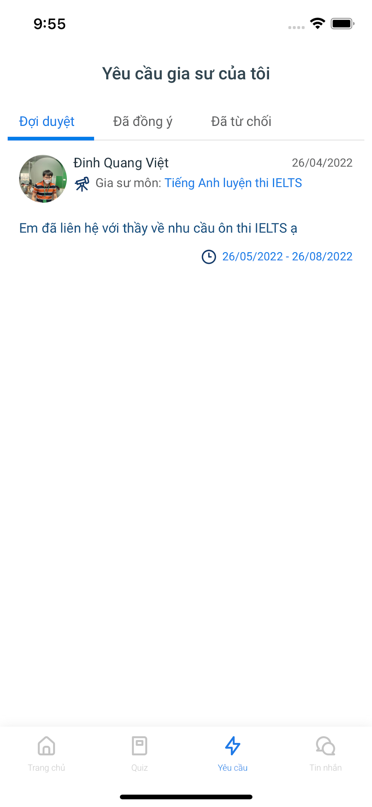
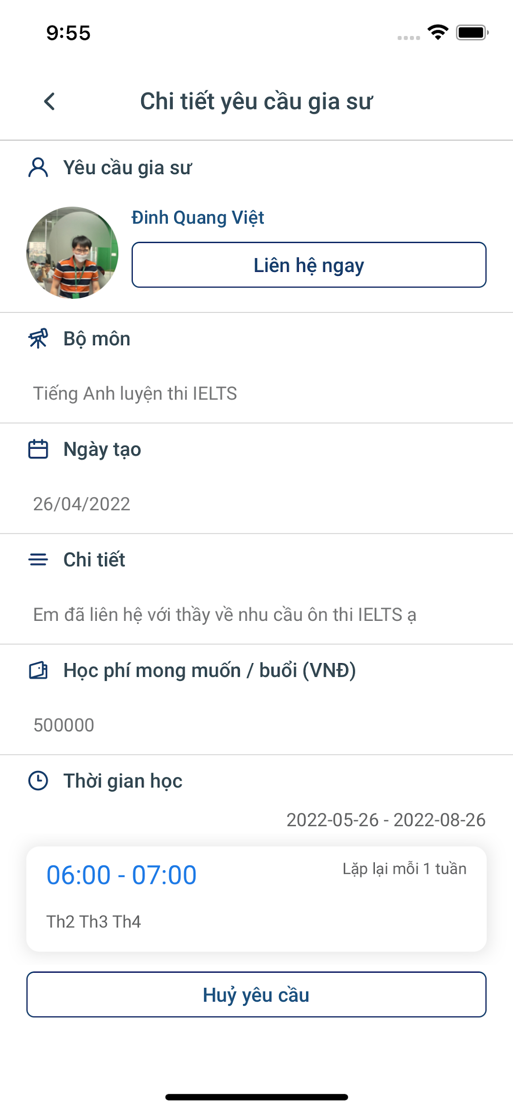
Student
Manage Mentors-finding Post
View Mentor Profile
Contact
Manage Mentorship Request
View Notification List
View Schedule
Take Quiz
Feedback Mentor

Slide 37
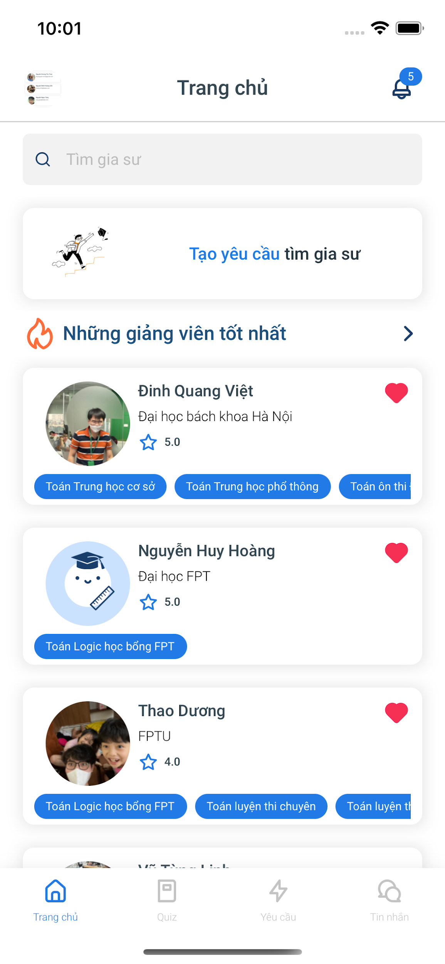
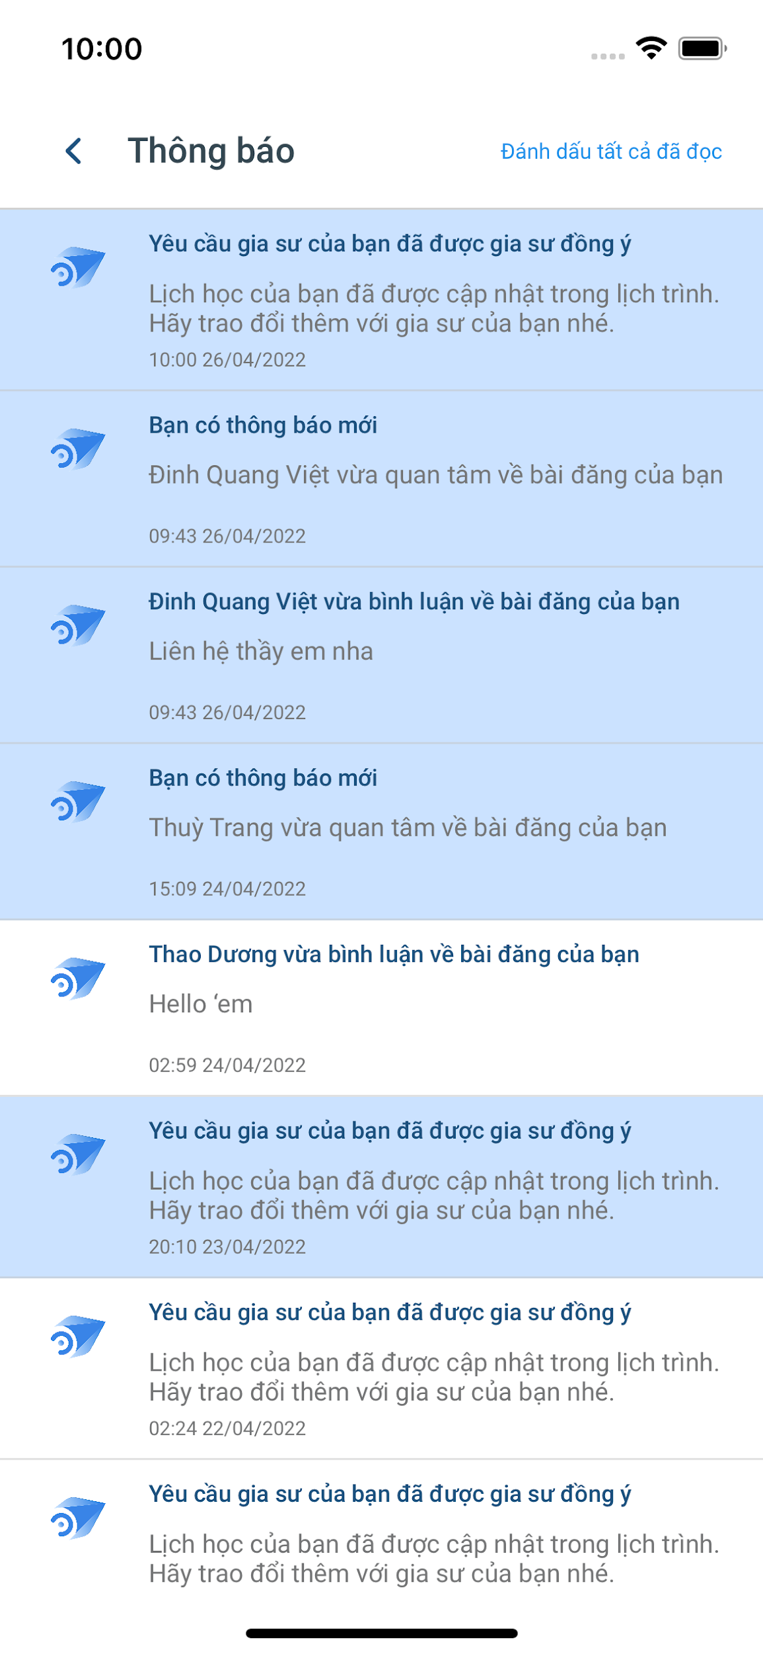
Student
Manage Mentors-finding Post
View Mentor Profile
Contact
Manage Mentorship Request
View Notification List
View Schedule
Take Quiz
Feedback Mentor

Slide 38




Student
Manage Mentors-finding Post
View Mentor Profile
Contact
Manage Mentorship Request
View Notification List
View Schedule
Take Quiz
Feedback Mentor

Slide 39





Student
Manage Mentors-finding Post
View Mentor Profile
Contact
Manage Mentorship Request
View Notification List
View Schedule
Take Quiz
Feedback Mentor

Slide 40



Student
Manage Mentors-finding Post
View Mentor Profile
Contact
Manage Mentorship Request
View Notification List
View Schedule
Take Quiz
Feedback Mentor

Slide 41


Mentor
Manage Mentors-finding Post
Contact
Manage Mentorship Request
View Notification List
View Schedule
Manage Quiz

Slide 42


Mentor
Manage Mentors-finding Post
Contact
Manage Mentorship Request
View Notification List
View Schedule
Manage Quiz

Slide 43



Mentor
Manage Mentors-finding Post
Contact
Manage Mentorship Request
View Notification List
View Schedule
Manage Quiz

Slide 44






Mentor
Manage Mentors-finding Post
Contact
Manage Mentorship Request
View Notification List
View Schedule
Manage Quiz

Slide 45


Admin
Manage User
Manage Quiz

Slide 46

Admin
Manage User
Manage Quiz

Slide 47
Non-functional Requirement
External Interfaces
User Interface
Hardware Interface
Software Interface
Quality Attributes
Performance
Reliability
Security

Slide 48
PROJECT INTRODUCTION
PROJECT MANAGEMENT
SOFTWARE REQUIREMENT
SPECIFICATION
SOFTWARE DESIGN
SOFTWARE TESTING
LESSON LEARNED
– DEMO – Q&A
Notes:
LAN

Slide 49
SOFTWARE DESIGN

Slide 50

Architecture Design
Notes:
Tass

Slide 51








CI/CD
Notes:
Tass

Slide 52


CI/CD
Notes:
Tass

Slide 53

Cloud Build Dashboard
Notes:
Tass

Slide 54


Slide 55

Package Diagram
Figure 4.2.1 Backend Package Diagram
Notes:
Tass

Slide 56

Database Diagram
Figure 4.3 Database Diagram

Slide 57


Slide 58

Database Diagram
Figure 4.4 “Manage Mentor-finding Post” Database Diagram
Notes:
Tass thêm 1 db diagram tổng quát trc slide này

Slide 59

Class Diagram
Figure 4.5 “Manage Mentor-finding Post” Class Diagram
Notes:
Tass

Slide 60

Sequence Diagram
Figure 4.6 “Create Mentorship Request Sequence Diagram

Slide 61

Package Diagram
Figure 4.2.2 Mobile Package Diagram
Notes:
Thủy NDT

Slide 62


Slide 63

UI/UX Design
Figure 4.7 UI/UX Design

Slide 64
PROJECT INTRODUCTION
PROJECT MANAGEMENT
SOFTWARE REQUIREMENT
SPECIFICATION
SOFTWARE DESIGN
SOFTWARE TESTING
LESSON LEARNED
– DEMO – Q&A
Notes:
LAN

Slide 65
SOFTWARE TESTING

Slide 66


Test Strategy

Slide 67
Testing Stages
Unit Test
Integration Test
System Test
Acceptance Test

Slide 68

Testing Stages
Unit Test
Unit Test
Regression
Test
Integration Test
API Test
Regression
Test
System Test
Functional
Test
GUI Test
Regression
Test
Acceptance Test
Functional
Test
GUI Test

Slide 69

Unit Test

Slide 70


Slide 71

Unit Test

Slide 72


Slide 73

Defect & Bug Log

Slide 74

Defect & Bug Log

Slide 75
Test Reports – Unit Test
Test coverage: | 100%
Test successful coverage: | 100%
Normal case: | 34.20%
Abnormal case: | 49.67%
Boundary case: | 15.96%

Slide 76

Integration Test & System Test

Slide 77


Slide 78

Test Reports – Integration Test & System Test

Slide 79

Defect & Bug Log

Slide 80

Defect Tracking

Slide 81

Defect Tracking

Slide 82

Acceptance Test

Slide 83
PROJECT INTRODUCTION
PROJECT MANAGEMENT
SOFTWARE REQUIREMENT
SPECIFICATION
SOFTWARE DESIGN
SOFTWARE TESTING
LESSON LEARNED
– DEMO – Q&A
Notes:
LAN

Slide 84
LESSON LEARNED – DEMO – Q&A

Slide 85





























Technology
Database
Deployment Server
TestFlight
Tools
Version Control
PM
Testing
Communication
CI/CD
Documentation & Diagramming
IDEs/Editors and Other Tools
XCode
Google Container
Registry

Slide 86





Technology
Development Process
Teamwork & Communication
System Design & Problem Solving

Slide 87


Slide 88

DEMO
Download ‘MentoringME’ by scanning this QR:

